Slide 1
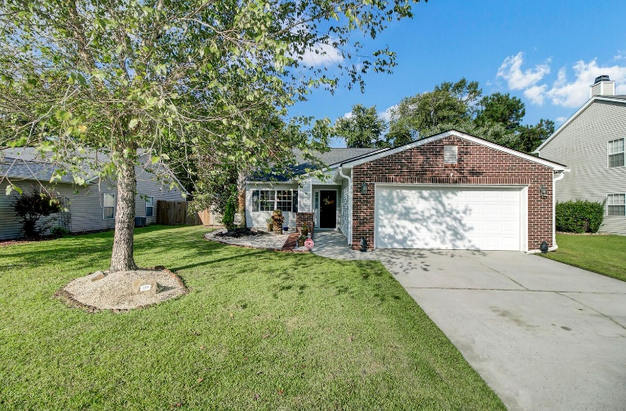
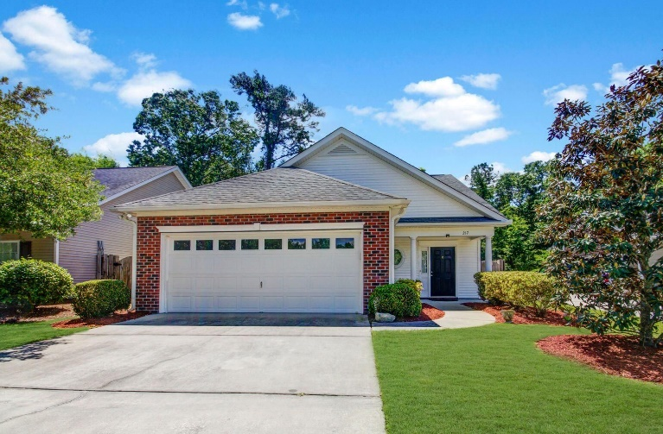
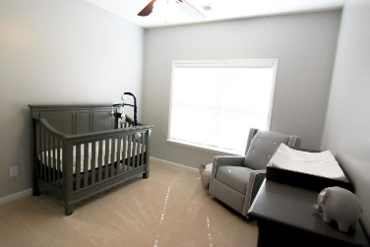
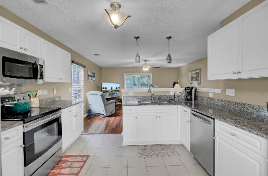
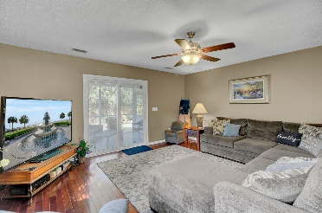
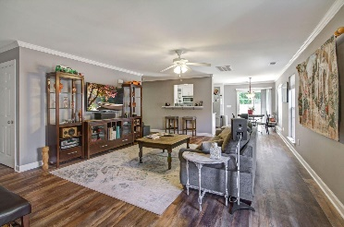
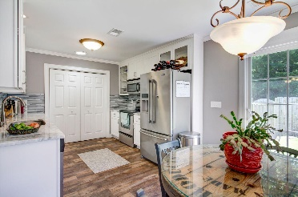
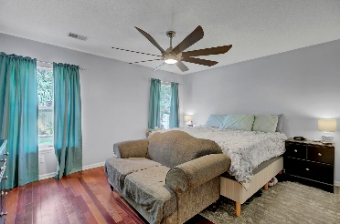
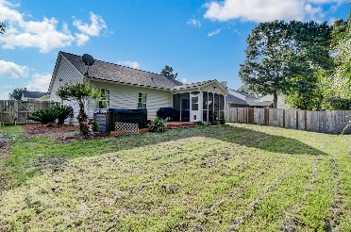
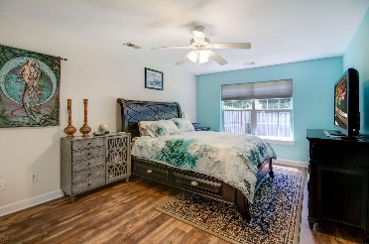
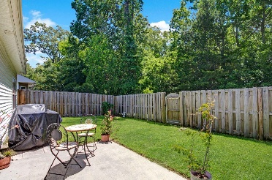




108 Creek Bend Drive MLS# 22023595 | $325,000
2 New Listings in Bridges of Summerville
OPEN HOUSE
Sun 12-3
$50 Gift Card Drawing
217 Garden Grove Drive MLS# 22023634 | $315,000
This is a unique opportunity to own a home in Summerville for only $325,000 and includes gorgeous open spaces yet defined rooms! There's a separate dining room that's open to the kitchen! The kitchen includes a white cabinet package, granite counter tops, stainless steel appliances and pendant lighting! You'll love the hardwood flooring that carries from the foyer to the dining room, to the family room and down the hallway leading to the bathroom. The owner's suite is great size and includes a walk-in closet and separate bathroom! The two secondary bedrooms are adorable and convenient to the owner's suite as well as the secondary bedroom. You'll also find a screen porch overlooking a large backyard with a thick tree buffer in the back for the ultimate privacy! Bridges of Summerville is a much sought after community that has a pool, playgrounds, sidewalks and more! It's close to everything and there are two main entrances opposite of one another making it one of the most convenient locations in Dorchester County! The hot tub in the backyard conveys AS-IS.
Welcome to 217 Garden Grove! This pristine and wonderfully updated home is located in sought after Gardens subsection of The Bridges of Summerville. Entering the home reveals the ideal open concept main living space, perfect for entertaining friends and family. Durable engineered wood flooring runs seamlessly through the main living space as well as the recently renovated kitchen! The extensive kitchen renovations include all stainless appliances, new cabinets, marble countertops and tile backsplash! Also downstairs is the spacious first floor owners suite, large walk in closet and full bath with tub / shower combo. Two additional bedrooms are found on the second floor. Both rooms offer great space, ample closet storage and easy access to the full common bath. Living space continues outdoors to the private backyard with a grilling patio all surrounded by a privacy fence. The house backs up into a wooded area. Or a short walk out the front door leads to a massive green space with a gazebo offering a place to beat the heat on hot summer days!
Beth Moore
M (843) 532-4892
bmoore@carolinaone.com
Meg H. Kandik
843-814-5137 | Meg@HolyCityRE.com www.holycityre.com
Matt Kimes
843-860-1669 | mattkimeshomes@gmail.com
www.mattkimeshomes.com
Brand Name Real Estate | 4 Carriage Ln | Charleston 29407

