Slide 1
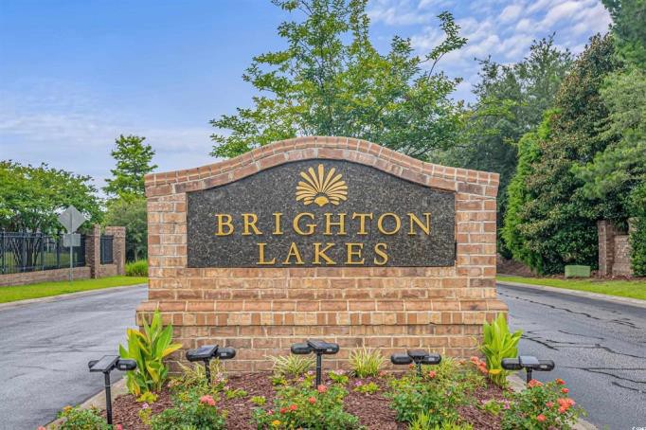
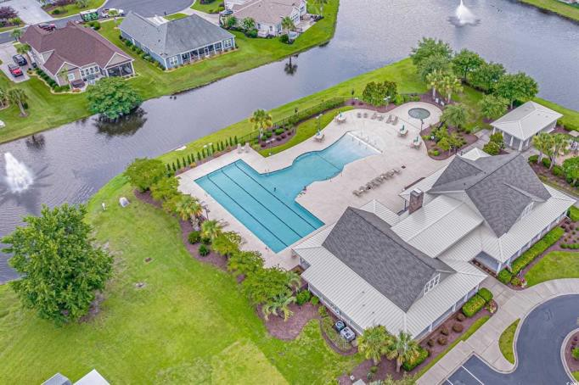
TOUR THESE FANTASTIC HOMES IN BRIGHTON LAKES
ENTER TO WIN EXCITING PRIZES
GIFT BASKETS, GAS CARD, STARBUCKS & AMAZON GIFT CARD
Enjoy the delicious selection of wraps, chips, fresh fruit and desserts
931 Wheatgrass Drive
JTE Real Estate
935 Desert Wheatgrass Drive
Remax Southern Shores
208 Switch Grass Court
Jerry Pinkas Real Estate Experts
Gate Code
2986
1315 Bernuda Grass Drive
Century 21 The Harrelson Group
1303 Bermuda grass Drive
BHHS Myrtle Beach Real Estate
112 Zoysia Grass Court
Highgarden Real Estate
WEDNESDAY, FEB 26TH 12PM-2PM
JOIN US FOR AN EXCLUSIVE TOUR OF HOMES.
ENJOY GREAT FOOD & NETWORK WITH FELLOW AGENTS

