Slide 1
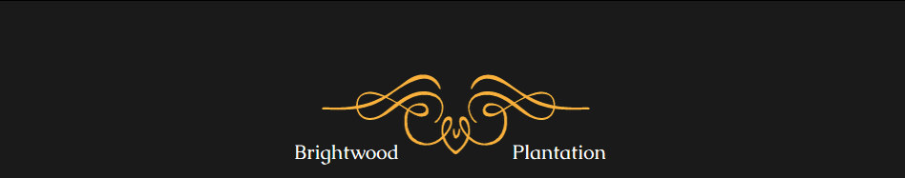

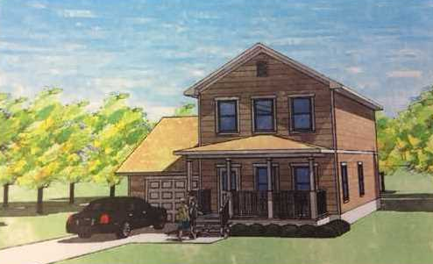
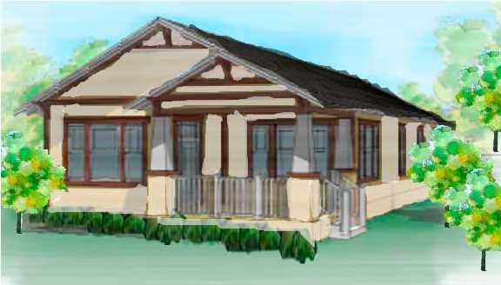
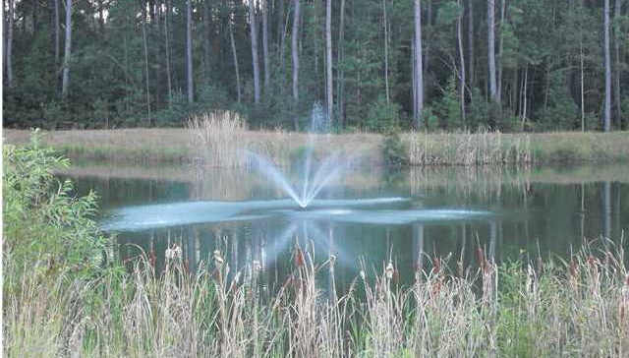
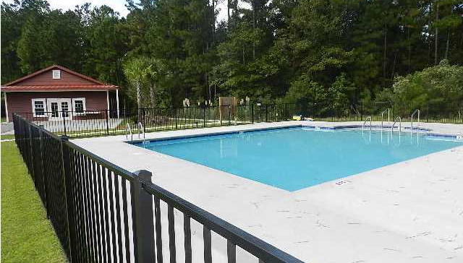


Brightwood Plantation Open House
Saturday, July 26 – From 1-3pm
Light Refreshments Will Be Available
Quality new construction at unbelievable prices. All high end features, granite, 42 inch maple cabinets, hardwood floors, and more.
This quiet community is surrounded by national forest yet still conveniently located to Clements Ferry Road, Mount Pleasant (10 minute ride), and I-526. Amenities include a gorgeous club house and pool. You will be amazed at how energy efficient your new home is! Most of these homes feature Energy Star rated insulated panels so the attic can only reach a maximum of 85 degrees! Many of these homes will also be SC Certified Safe Homes, meaning there are extra hurricane features above and beyond what is required by code. These homes will be capable of withstanding 190 mph winds! These features can get you a discount of up to 20% on your homeowners insurance. Buyer may use lender of their choice, however with seller's preferred lender buyer may be eligible for lender paid closings costs of 1% of the loan amount, redeemable only at the time of closing when financing is completed by the seller's preferred lender. Closing costs credit must be mentioned at application and may only be applied to offset actual costs. USDA financing also available to qualified buyers with no money down!
Aviles Real Estate Brokerage
Susan Aviles
843-697-2383
Gil Aviles
843-697-5535
www.Aviles-RealEstate.com

