Slide 1
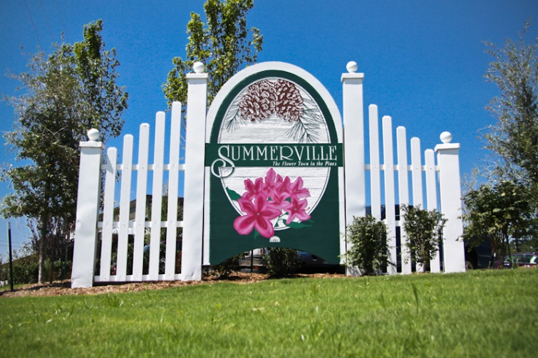


Downtown CASH Buyer
Hi All,
I have a buyer looking for a 2+ bedroom home, remodeled, with off-street parking, and no interior flooding in the past. The are looking for up to $1M and are cash buyers. Close to Broad preferable for walking to Broad and East Bay shopping and eating.
Buyers have seen everything already in the MLS.
Please email only so I may share with my client.
Thank you,
Brian
Brian Walsh
(843) 754-2089 | bwalsh@carolinaone.com
www.carolinaonerealestate.com/brianwalsh
Carolina One Real Estate | 49 Broad St | Charleston, SC 29401

