Slide 1
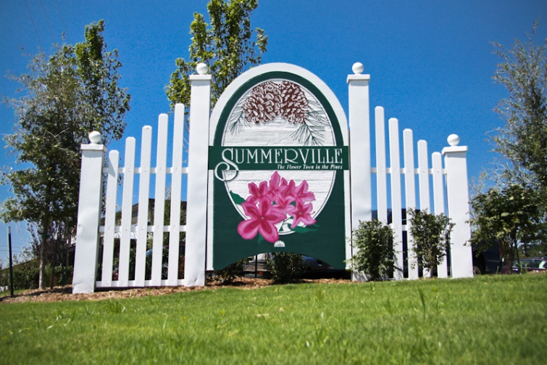


Downtown Buyer is Ready!
Hi All,
Any new single family homes coming on market soon South Of Broad?
Please email only so I may share with my client.
Thank you,
Brian
Brian Walsh
(843) 754-2089 | bwalsh@carolinaone.com
www.carolinaonerealestate.com/brianwalsh
Carolina One Real Estate | 49 Broad St | Charleston, SC 29401

