Slide 1
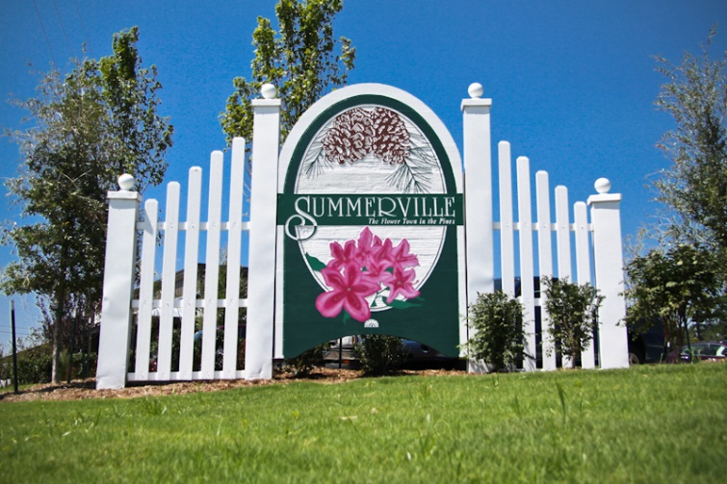


Client Looking for Investment Property
Hi All,
My client is interested in finding a potential investment property that can either be built for a small condo building or a building that could be renovated. She is really looking to develop something from the ground up, renovate existing building as a build out, or piece of property that she can build on in and around the area, but does not have to be downtown.
Please email only so I may share with my client.
Thank you,
Brian
Brian Walsh
(843) 754-2089 | bwalsh@carolinaone.com
www.carolinaonerealestate.com/brianwalsh
Carolina One Real Estate | 49 Broad St | Charleston, SC 29401

