Slide 1
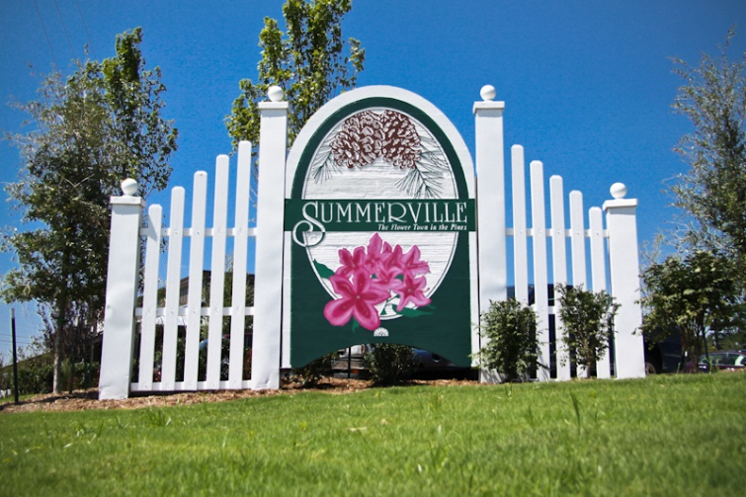


HOUSE NEEDED!
Client looking for a home up to $250K, one story in either the Cainhoy area or in Hanahan.
Preapproved and Ready to Move.
Please contact me if there are any pocket listings out there.
Buyer Looking in Hanahan or Cainhoy/Wando
Carey Nikonchuk
(843) 276-1701 M
cnikonchuk@gmail.com
www.palmettoproperty.net

