Slide 1
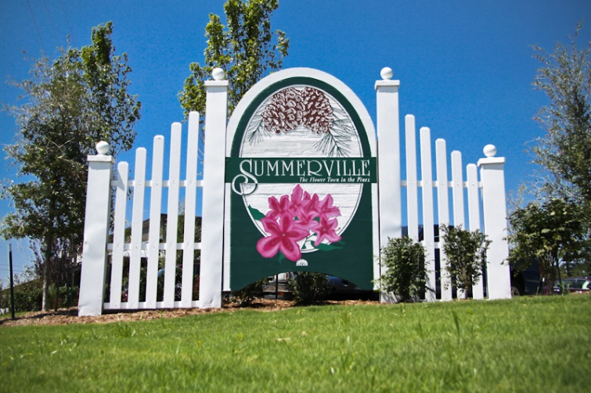
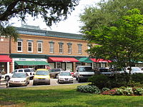
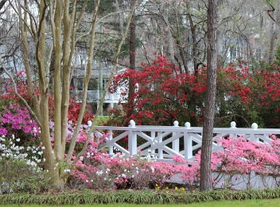
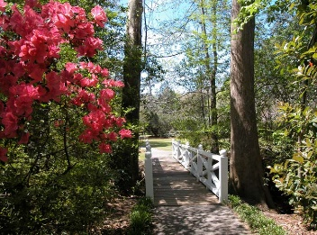
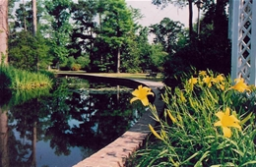
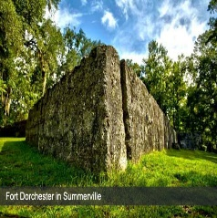
Need to find a home for my buyers ASAP $300,000-$410,000, in Summerville, Subdivision that is zoned for Ashley Ridge or SHS, larger lot, brick or cement plank. Can close end of March, beginning of April. If you have a pocket listing or know of something coming on the market soon, contact me!
Buyer Looking in Dorchester District 2
Hillary Jones
843 709-4666
hillaryjones@sc.rr.com

