Slide 1
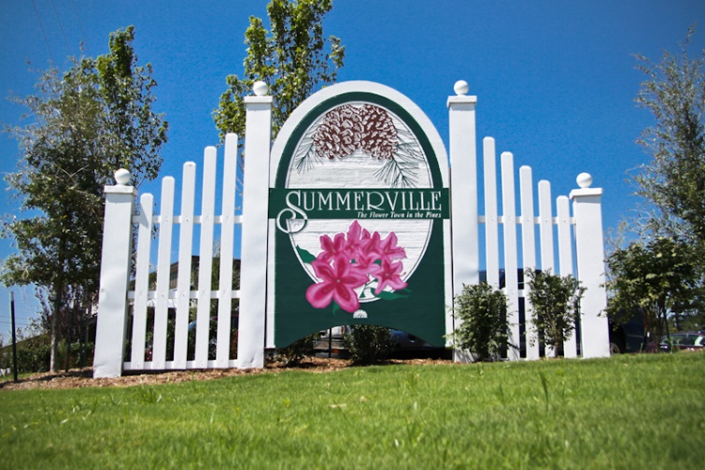
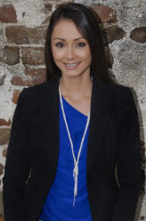

We have a few investor clients looking to make multiple purchases in and around the Charleston area. These clients are open to any price point, but the properties must have a 8-10% Cap Rate. The larger scale the property the better!
Investor Clients Need to Purchase Now!!
JERICHA A. MCGEE
Mobile - (843) 568-1767
jdelia@mycharlestonproperty.com
www.mycharlestonproperty.com

