Slide 1
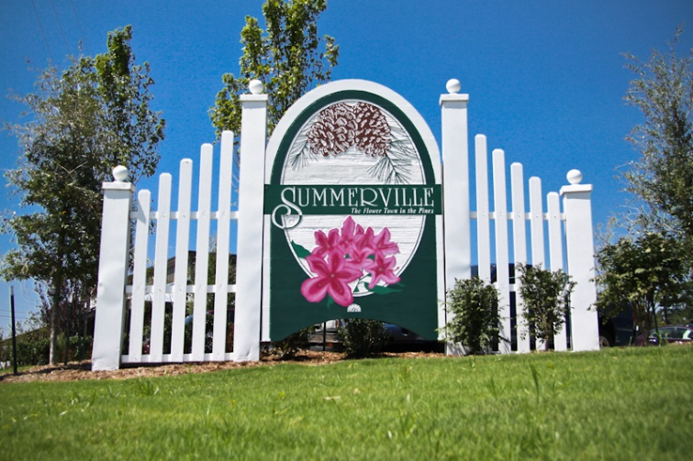


Looking for Various Real Estate in West Ashley & North Area
…Can you help?
Residential
  Employee housing, ugly or fixer-uppers preferred or required, as I am a general contractor/developer and have my own crew.
  South of I-26 or west of I-526
  4 bedroom min, bigger the better
  Large lot
  Multi family ok
  Extra storage or seclusion a plus.
Industrial/Commercial
  A light industrial warehouse (same search area)
  Office space a plus
  Loading bay a plus
  Multi-tenant a plus.
Vacant Land
  Raw or semi-raw land for development
  Agricultural or better zoning, not residential
  Some structure power and water a plus.
Owner financing preferred
Strong financial documentation available upon request
James Parker
843-886-8900
jparker815@aol.com

