Slide 1
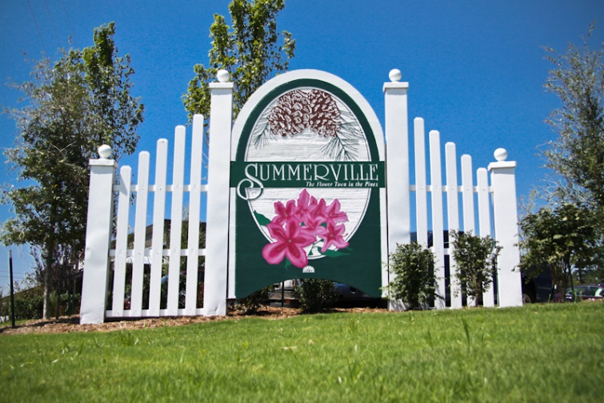


Buyer Looking in Mt Pleasant or James Island
Hi All,
Buyer ISO a home in Mount Pleasant South of 41, James Island, or West Ashley inside 526 with Master on the first floor. $800k to $1.2M, 3-5 beds, 2+ baths, little to no work needed, btw 2400 & 3,600k Sqft.
We have seen all in the MLS, does anyone have a pocket listing or soon to be listed home that meets this criteria? Please email me at bwalsh@carolinaone.com, so I may forward anything to my client for a visit early next week.
Thank you,
Brian
Brian Walsh
(843) 754-2089 | bwalsh@carolinaone.com
www.carolinaonerealestate.com/brianwalsh
Carolina One Real Estate | 49 Broad St | Charleston, SC 29401

