Slide 1
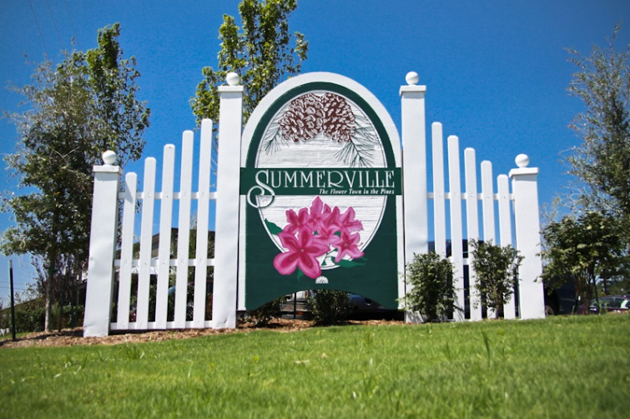


Buyer Looking in Mt Pleasant or James Island
Hi All,
ISO a home in Mount Pleasant South of 41 or James Island with Master on the first floor. $800k to $1.1M, 3-5 beds, 2+ baths, garage, and btw 2300 & 3,600k Sqft.
We have seen all currently in the MLS.
Does anyone have a pocket listing or soon to be listed home that meets this criteria?
Please email me at bwalsh@carolinaone.com.
Thank you,
Brian
Brian Walsh
(843) 754-2089 | bwalsh@carolinaone.com
www.carolinaonerealestate.com/brianwalsh
Carolina One Real Estate | 49 Broad St | Charleston, SC 29401

