Slide 1
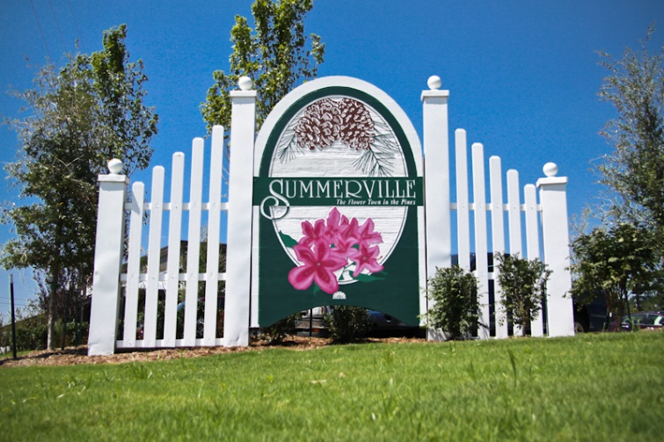


Buyer Looking in Mount Pleasant or James Island
Hi All,
ISO a home in Mount Pleasant or James Island with Master Down. $800,000-$1.200,000. 3-5 bedrooms, no more than 4,000 Sqft.
We have seen all currently in the MLS.
Does anyone have a pocket listing or soon to be listed home that meets this criteria?
Please email me at bwalsh@carolinaone.com.
Thank you,
Brian
Brian Walsh
(843) 754-2089 | bwalsh@carolinaone.com
www.carolinaonerealestate.com/brianwalsh
Carolina One Real Estate | 49 Broad St | Charleston, SC 29401

