Slide 1
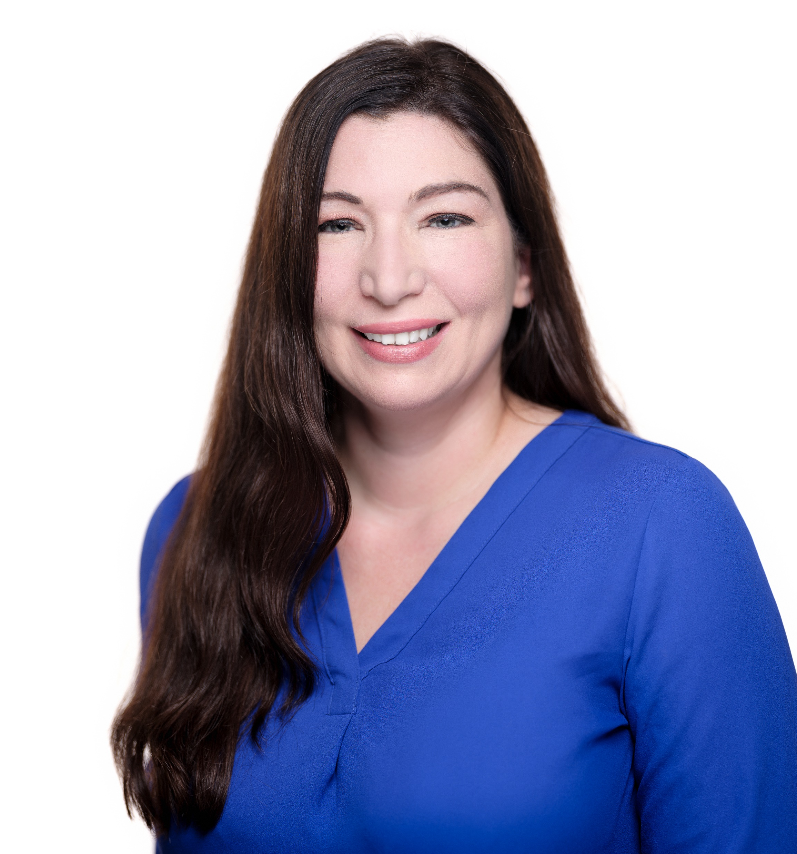

Buyers Need A Church
Buyers prefer:
Below $800,000
1500+ square feet
Newer building(s)
Summerville, Ladson, or North Charleston area
If you have something coming up, let me know.
Thanks!
Jacqui Swain (843) 295-9484 jacqui.swain@carolinaone.com www.jacquisellscharleston.com
Carolina One Real Estate | 1530 Old Trolley Road | Summerville, SC 29485

