Slide 1
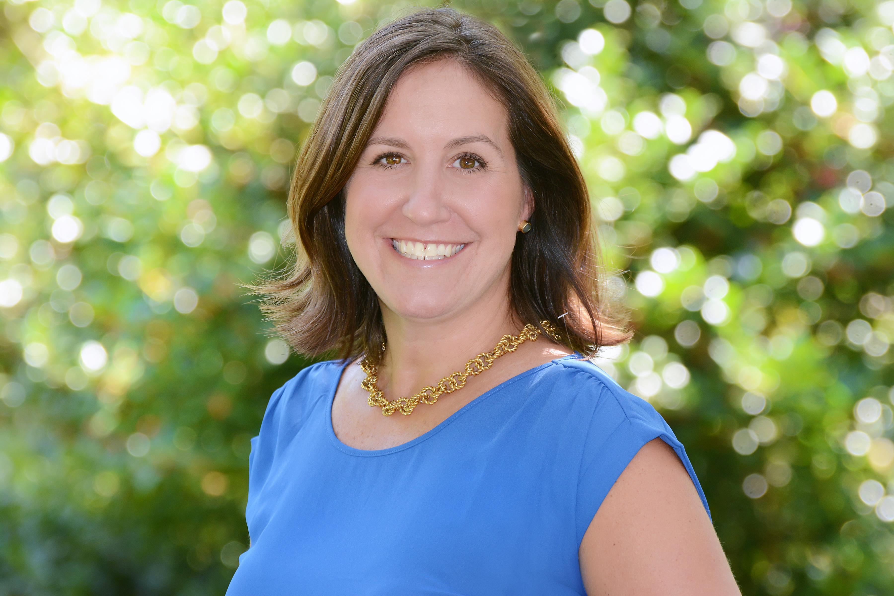

Buyer Looking on Isle of Palms
I have a serious buyer looking for an off-market single family home on IOP in the $600k’s.
3 Bed/2 Bath
We have seen everything on MLS.
If you have a listing coming up or know of something that might work please let me know!
Thanks!
Keller Williams Realty
Charleston West Ashley
1180 Sam Rittenberg Ste 105
Charleston, SC 29407
Amy Zonarich Powers
Realtor
(843) 534-3523
amy@amyzonarich.com
www.liveandlovecharleston.com

