Slide 1
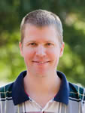

Buyer Looking in Mt Pleasant
I have a buyer looking for an Off Market House in Mount Pleasant between $450,000 - $550,000.
They would prefer a home in the Charles Pinckney Elementary school zone.
We have seen everything on MLS.
If you have a listing coming up or know of something that might work, please let me know!
Thanks!
Jason Newhauser
(843) 534-6564
jasonsellscharleston@gmail.com
www.jasonnewhauser.com
COLDWELL BANKER RESIDENTIAL BROKERAGE
1127 QUEENSBOROUGH BLVD. 103
MT PLEASANT, SC 29464

