Slide 1
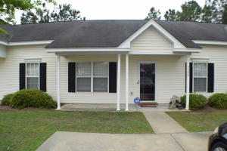
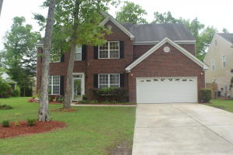
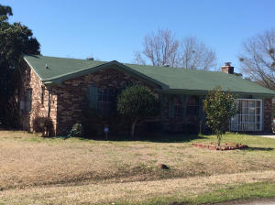
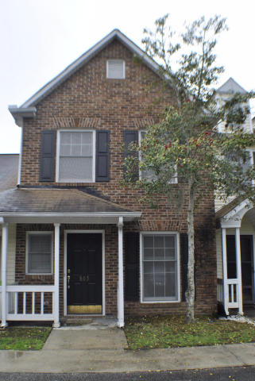

Agent Bonuses Available Ratify by 5/15/15…Close by 6/30/15
$1,500 Bonus
$500 Bonus
$1,000 Bonus
7364 Suncatcher Drive
Tanner Plantation
Hanahan
MLS# 1426519
$118,000
$500 Bonus at Closing!
9257 N Moreto Circle
Wescott Plantation
Summerville
MLS# 15010069
$285,000
$2,000 Bonus at Closing!
4413 Jenwood Street
Woodside Manor
Ladson
MLS# 15005917
$75,000
$500 Bonus at Closing!
803 Reserve Way
Kings Grant
Summerville
MLS# 15008049
$104,900
$1,000 Bonus at Closing!
Corwyn J. Melette
Accredited Buyer Representative
(843) 364-3095
corwyn@corwynmelette.com
Exit Realty Lowcountry Group 3618 Ashley Phosphate Rd. #3
North Charleston, SC 29418
exitlowcountry.com

