Slide 1
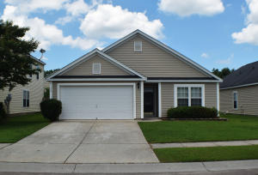
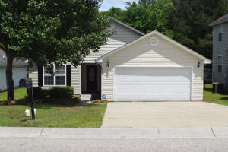
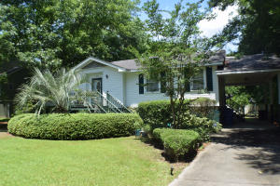
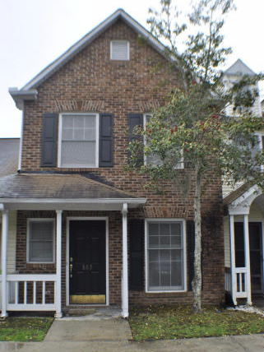

CJM Smart Buys!
$500 Bonus
$1,000 Bonus
4% Commission
304 Bradley Bend Drive
Moss Grove Plantation
Moncks Corner, SC 29461
MLS# 15015616
$167,500
8114 Honeysuckle
Pepperidge
North Charleston, SC 29420
MLS# 15012267
$159,900
Buyer to receive 5 Day/4 Night cruise for 2.
Ratify by June 30, 2015, and close by July 31,2015.
4% Commission
3630 Barton
Westland
Johns Island, SC 29455
MLS# 15013594
$147,870
803 Reserve Way
Kings Grant
Summerville
MLS# 15008049
$103,000
Corwyn J. Melette
Accredited Buyer Representative
(843) 364-3095
corwyn@corwynmelette.com
Exit Realty Lowcountry Group 3618 Ashley Phosphate Rd. #3
North Charleston, SC 29418
exitlowcountry.com

