Slide 1
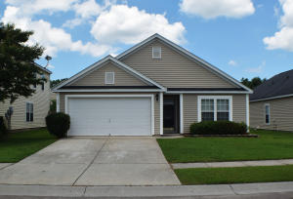
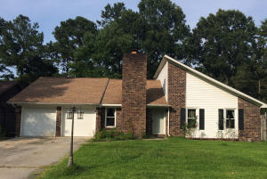
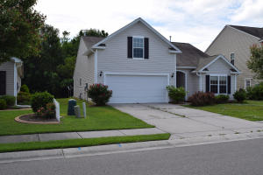

CJM Smart Buys!
$500 Bonus
$1,000 Bonus
4% Commission
304 Bradley Bend Drive
Moss Grove Plantation
Moncks Corner, SC 29461
MLS# 15015616 ~ $167,500
1301 Bishop Pines Drive
Tall Pines
Ladson, SC 29456
MLS# 15016919 ~ $135,000
Buyer to receive 5 Day/4 Night cruise for 2.
~ ALSO ~
$1,000 Bonus to the Agent
Ratify by July 31, 2015, and close by August 30,2015
Short Sale
1102 Cates
Myers Mill
Summerville, SC 29483
MLS# 15012253 ~ $179,900
Corwyn J. Melette
Accredited Buyer Representative
(843) 364-3095
corwyn@corwynmelette.com
Exit Realty Lowcountry Group
3618 Ashley Phosphate Rd. #3
North Charleston, SC 29418
exitlowcountry.com

