Slide 1
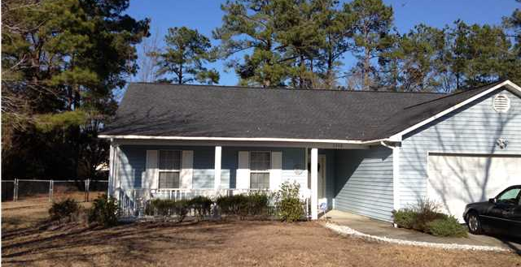
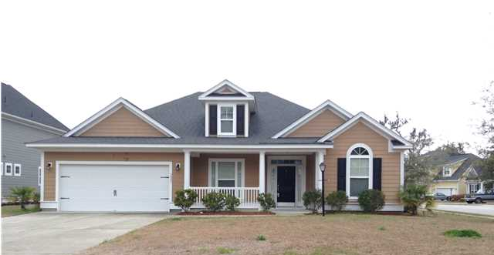
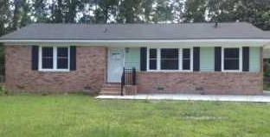

Agent Bonuses Available
Ratify by 10/24…Close by 11/28
$500 Bonus
$1,000 Bonus
$1,500 Bonus
3342 Pinewood Dr
Ridgewood :: Ladson :: MLS# 1404159 :: $169,900
$1,500 Bonus at Closing!
3901 Carpentaria Ct
Indigo Palms :: North Charleston :: MLS# 1408313 :: $214,900
$2,000 Bonus at Closing!
7707 Picardy Pl
Pepperhill :: Charleston :: MLS# 1413388 :: $99,400
$500 Bonus at Closing!
Corwyn J. Melette, BIC
Accredited Buyer Representative
843-619-0071
corwyn@corwynmelette.com
Corwyn J Melette & Associates
PO Box 2175
Goose Creek, SC 29445 www.corwynmelette.com

