Slide 1
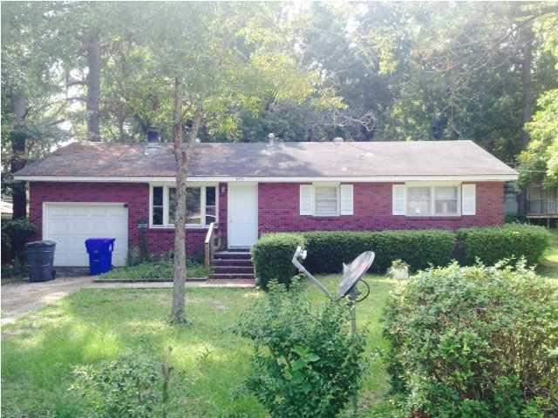
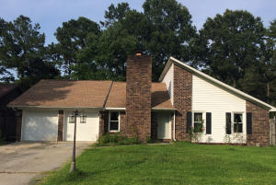
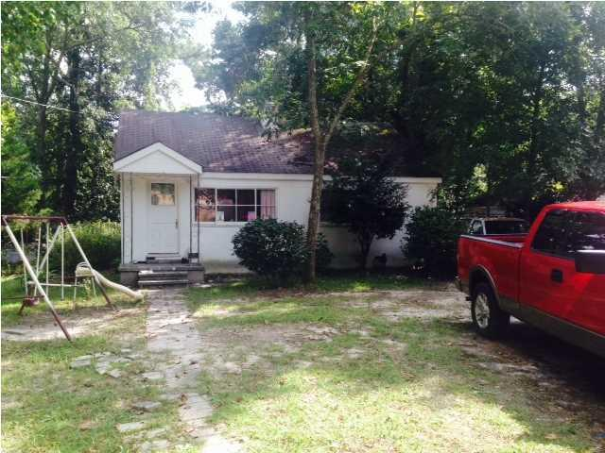

CJM Smart Buys in Charleston Farms
$500 Bonus
$1,000 Bonus
4% Commission
5471 Attaway Street ~ North Charleston, SC 29406 ~ MLS# 1425048 ~ $80,000
$500 Agent Bonus
Ratify by July 31 & close by August 30
1301 Bishop Pines Drive
Tall Pines
Ladson, SC 29456
MLS# 15016919 ~ $135,000
Short Sale
1507 Sumner Avenue ~ North Charleston, SC 29406 ~ MLS# 1425046 ~ $85,000
Corwyn J. Melette
Accredited Buyer Representative
(843) 364-3095
corwyn@corwynmelette.com
Exit Realty Lowcountry Group 3618 Ashley Phosphate Rd. #3
North Charleston, SC 29418
exitlowcountry.com

