Slide 1
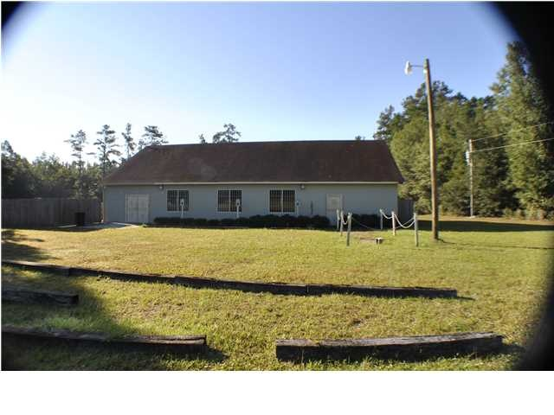
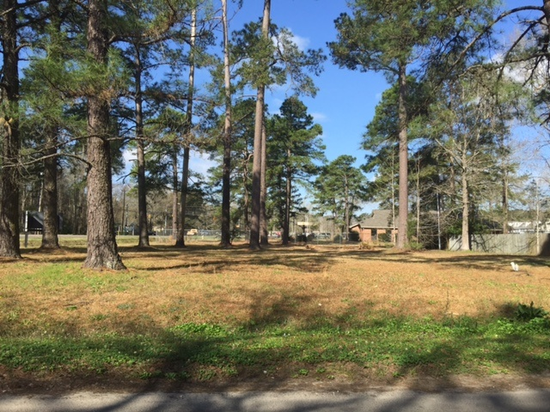

CJM Commercial Properties
23746 Augusta Hwy
Cottageville, SC 29435
MLS# 29853506 ~ $249,000
0 Central Ave
Summerville, SC 29483
MLS# 29943596 ~ $99,000
Former restaurant and former sports bar that occupies a large parcel. Property features a baseball field with stands. Lots of space for parking both in front and rear. Building conveys with all equipment installed. Grease trap, fire suppression system, DHEC approved full kitchen. Has two customer bathrooms and one staff restroom that has a shower. Full bar with cooler is just the start. Great opportunity to open a new sports bar or restaurant.
Former residential lot recently rezoned to B-3. Tons of potential uses for the lucky buyer. Property had water, sewer, and electricity.
Corwyn J. Melette
Accredited Buyer Representative
(843) 364-3095
corwyn@corwynmelette.com
Exit Realty Lowcountry Group
3618 Ashley Phosphate Rd. #3
North Charleston, SC 29418
exitlowcountry.com

