Slide 1
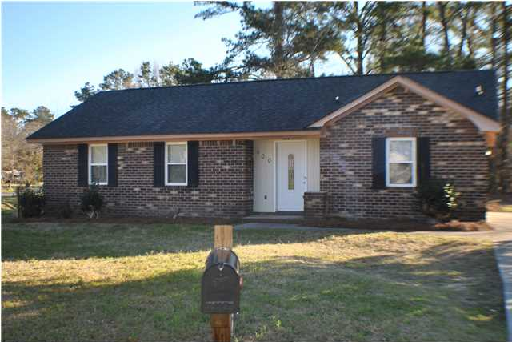
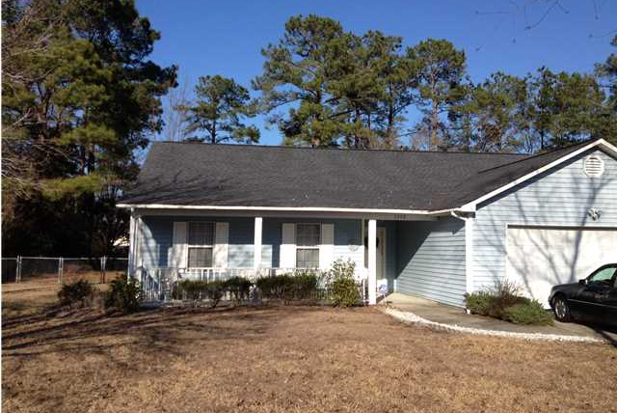
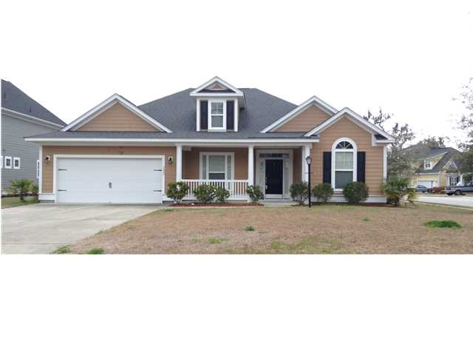

A Cruise For Your Buyer… A Bonus for You!
$500 Bonus
$1,000 Bonus
$1,500 Bonus
400 Violet Dr
Robynwyn
Summerville
MLS# 1406763
$99,800
3342 Pinewood Dr
Ridgewood Ladson MLS# 1404159 $171,900
3901 Carpentaria Ct
Indigo Palms
North Charleston MLS# 1408313 $217,000
Buying a new home should be a Fantastic Voyage...so buy this one during the month of July and we will send you on one! Our "Summer of Fun" begins with the buyer of this home receiving a 5 day/4 Night Cruise Certificate for Two to Mexico, the Bahamas, or the Western Caribbean at closing! This one was waiting just for you! Located in Summerville, within a few blocks of downtown, this home is ready. Owner has extensively remodeled home. Updated features include new light fixtures, plumbing fixtures, new cabinets, new countertops, new windows, new flooring, new roof, and a host of other features. Located in Dorchester county with schools and shopping within a short distance. Home sits on corner lot, so access to yard space is easy.
Buying a new home should be a Fantastic Voyage...so buy this one during the month of July and we will send you on one! Our "Summer of Fun" begins with the buyer of this home receiving a 5 day/4 Night Cruise Certificate for Two to Mexico, the Bahamas, or the Western Caribbean at closing! This home is located in the Ladson area and is at true 4 bedroom home on just over a half acre lot! You can't beat that alone. Newer roof and other updates. The home is laid out with a very functional floor plan. Open the front door and you are greeted by a very wide foyer that offers you a number of options. You can go straight ahead into the great/family room with vaulted ceiling and fireplace.
Buying a new home should be a Fantastic Voyage...so buy this one and we will send you on one! Our "Summer of Fun" begins with the buyer of this home receiving a 5 day/4 Night Cruise Certificate for Two to Mexico, the Bahamas, or the Western Caribbean at closing! Why wait to build when you can buy this one now? In a word, this one is ready. Ready for a new owner! Located in North Charleston close to shopping and recreation, this one is...READY! This is a 3 bedroom masterpiece with granite countertops, upgraded cabinets, newer appliances, and new fixtures. Open the front door and you are welcomed to a spacious layout with formal dining area that leads you to the family room. There is a formal living room that could be used as a study adjacent to the foyer. The kitchen is open and has a eat-in area. All of this overlooks the family room.
Corwyn J. Melette, BIC
Accredited Buyer Representative
843-619-0071
corwyn@corwynmelette.com
Corwyn J Melette & Associates
PO Box 2175
Goose Creek, SC 29445 www.corwynmelette.com

