Slide 1
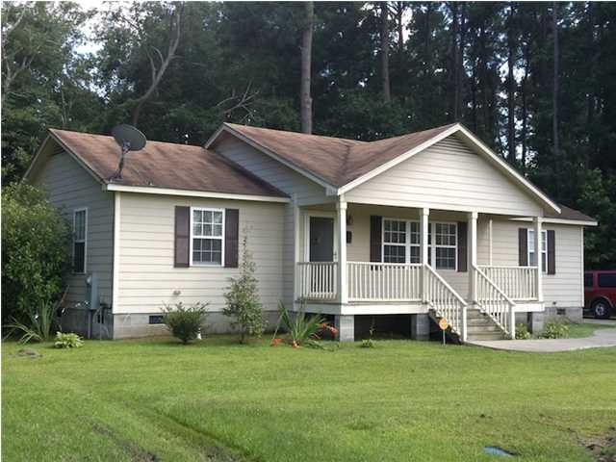
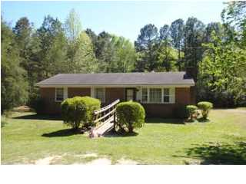
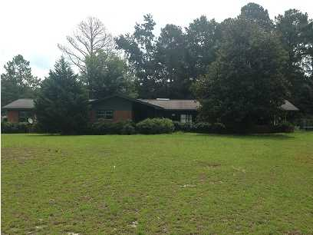

Bring Us an Offer Today!
Buy one of these homes during the month of September and we will send you on a cruise!
Our "Summer of Fun" begins with the buyer of this home receiving a 5 day/4 Night Cruise Certificate for Two to Mexico, the Bahamas, or the Western Caribbean at closing!
$500 Bonus
$1,000 Bonus
$1,500 Bonus
216 Floyd St
Mullins
MLS# 1320893
$79,900
255 James Rd
Marion
MLS# 1316936
$45,000
2941 Winburn Dr
Florence
MLS# 1419939
$109,000
Come see this charmer just off Main St. Located in the rural setting of Mullins SC with a backdrop of farms and a small town feel, this home is a great opportunity. This home is situated on just shy of an acre of land which provides plenty of space to expand. The owner constructed this home with a full front porch and rear deck with plenty of room to entertain. Inside, the home is finished with wood flooring throughout the common areas and ceramic tiles in the wet places. The family room is very open, so game night can be pulled off without a hitch! The home is located two blocks from the Kindergarten and Primary Schools, so getting the little one off in the morning could be a breeze. Shopping is also just a few blocks as well along with recreation. A short drive to the beach, the river, hunting, or to get to the interstate for other travel. This one is priced to sell. Don't miss out on this opportunity!
This your gem off the beaten path! Located just off Hwy 76 in between Marion and Florence, this home features a very functional layout. The family room is very open and features a fireplace. Off the family room is the kitchen and dining area. The kitchen is a cozy workspace that provides the cook good counter space. The home has 3 bedrooms that are all nicely sized. Home does need some work, so it is priced accordingly. Year built is an estimate by owner.
This one is a diamond that is a little rough. Here is your opportunity to pick up a large home on a large lot and put a little tlc into it to have a great home! Located just into the Darlington County area outside of the Florence City limits, this home has a lot to offer. Sitting on a large corner lot, this large range offers a separate entrance into what has been turned into a mother-in-law suite. On the far end of the house is a separate kitchen, dining, living, and bedroom that can be separated from the main portion of the house by a door. So bring "Mom" along with you on the move! The rest of the house is very spacious with a large master bedroom, huge family area, and separate dining room. Outside, there are two detached garages, perfect for storing the toys or just an area to hang out away from the main house. Plenty of room to roam. So the not so good? The house needs flooring and could use some updating on appliances. Not a bad trade off....for an opportunity such as this. The HVAC unit is not responding.
Corwyn J. Melette, BIC
Accredited Buyer Representative
843-619-0071
corwyn@corwynmelette.com
Corwyn J Melette & Associates
PO Box 2175
Goose Creek, SC 29445 www.corwynmelette.com

