Slide 1
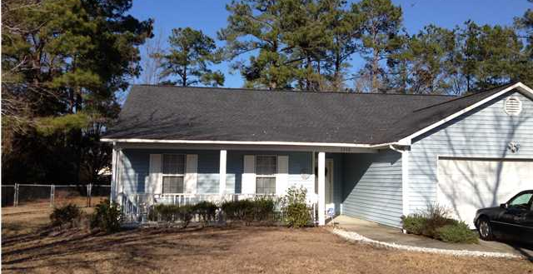
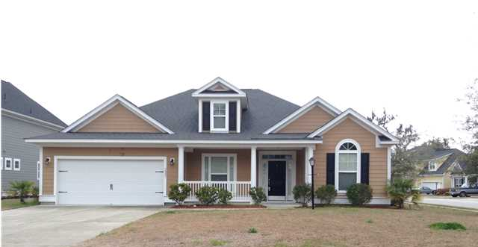

Buying a New Home Should be a Fantastic Voyage
Buy one of these homes during the month of September and we will send you on one!
Our "Summer of Fun" begins with the buyer of this home receiving a 5 day/4 Night Cruise Certificate for Two to Mexico, the Bahamas, or the Western Caribbean at closing!
$500 Bonus
$1,000 Bonus
$1,500 Bonus
3342 Pinewood Dr
Ridgewood :: Ladson
MLS# 1404159
$169,900
3901 Carpentaria Ct
Indigo Palms :: North Charleston
MLS# 1408313
$214,900
This home is located in the Ladson area and is at true 4 bedroom home on just over a half acre lot! You can't beat that alone. Newer roof and other updates. The home is laid out with a very functional floor plan. Open the front door and you are greeted by a very wide foyer that offers you a number of options. You can go straight ahead into the great/family room with vaulted ceiling and fireplace. Yep, that is where you can go to just relax right? The current occupant has the space set up to entertain with both a living set and large dining while still having lots of space to move around. To the right is a short hallway that carries you to the secondary bedrooms and a full bath. Each bedroom is spacious and has easy access to that shared bath. To the left, is the master bedroom. You will be surprised by the size. The occupant currently has a king size bed set and a small living set with entertainment area in use. The kitchen features an eat-in area and pantry with a good amount of counter space. Now let's move to the next big feature. Out back there is a screened porch that is large enough to accommodate a seating area and small dining area...again plenty of room for entertaining. Outside the screened porch is a patio area leading to a large deck. All of this overlooking an enormous back yard. Enough room for a pool or other structures and the area is not governed by additional restrictions. This property may qualify for down payment assistance, so feel free to inquire with your agent.
Why wait to build when you can buy this one now? In a word, this one is ready. Ready for a new owner! Located in North Charleston close to shopping and recreation, this one is...READY! This is a 3 bedroom masterpiece with granite countertops, upgraded cabinets, newer appliances, and new fixtures. Open the front door and you are welcomed to a spacious layout with formal dining area that leads you to the family room. There is a formal living room that could be used as a study adjacent to the foyer. The kitchen is open and has a eat-in area. All of this overlooks the family room. The home has a split bedroom plan with the master bedroom separated with tub and separate shower. Dual vanities and marble counterops....READY! Couple this retreat with a huge walk-in closet and you are READY to accessorize! On the other side of the house, you will find two secondary bedroom separated by the bathroom and linen closet off a short hall. This one is not the house to be disappointed in. Lots of space, close to the neighborhood amenities, short distance to where you are going! READY....for you!
Corwyn J. Melette, BIC
Accredited Buyer Representative
843-619-0071
corwyn@corwynmelette.com
Corwyn J Melette & Associates
PO Box 2175
Goose Creek, SC 29445 www.corwynmelette.com

