Slide 1
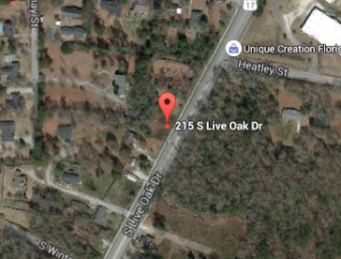
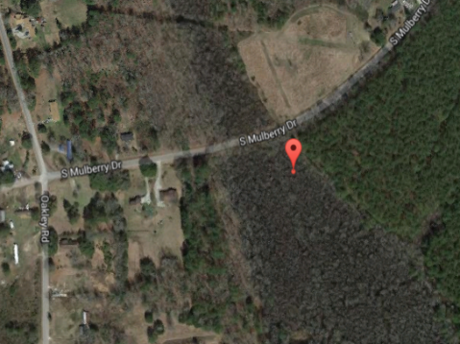
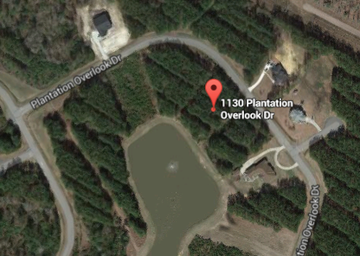
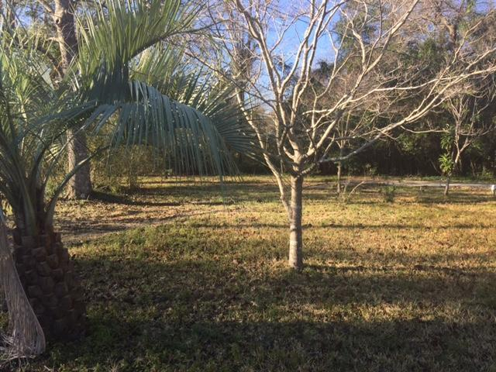
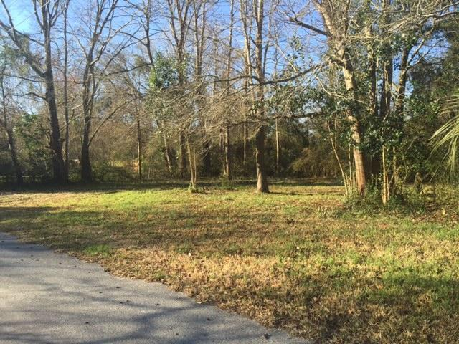

CJM Smart Buys!
Buyer to receive 5 Day/4 Night cruise for 2.
~ ALSO ~
$1,000 Bonus to the Agent
Ratify by July 31, 2015, and close by August 30,2015
$500 Bonus
$1,000 Bonus
215 S Live Oak Drive
Moncks Corner, SC 29461
MLS# 16008935
$75,000
0 S Mulberry Drive
Moncks Corner, SC 29461
MLS# 16008933
$25,000
4% Commission
1130 Plantation Overlook
Wassamassaw Plantation
Moncks Corner, SC 29461
MLS# 16003101
$59,000
Short Sale
8965 Selah Street
Deer Park
Charleston, SC 29406
MLS# 16004887
$23,000
8949 Selah Street
Deer Park
Charleston, SC 29406
MLS# 16004885
$23,000
Corwyn J. Melette
Accredited Buyer Representative
(843) 364-3095
corwyn@corwynmelette.com
Exit Realty Lowcountry Group 3618 Ashley Phosphate Rd. #3
North Charleston, SC 29418
exitlowcountry.com

