Slide 1
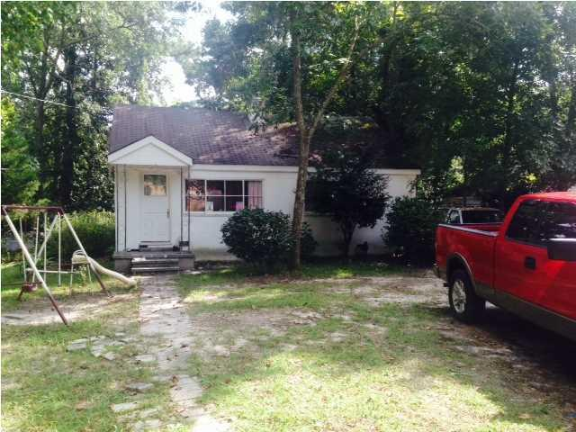
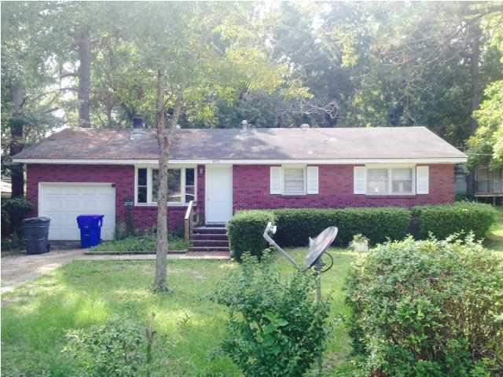
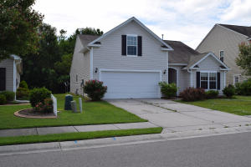

Just Reduced!
Buyer to receive 5 Day/4 Night cruise for 2.
~ ALSO ~
$1,000 Bonus to the Agent
Ratify by July 31, 2015, and close by August 30,2015
$500 Bonus
$1,000 Bonus
4% Commission
1507 Sumner Avenue
Charleston Farms
North Charleston, SC 29406
MLS# 1425046
$82,500
5471 Attaway Street
Charleston Farms
North Charleston, SC 29406
MLS# 1425048
$82,500
Located in North Charleston close to everything, come pick up what you have been missing. This property has a lot of potential. Currently, the home is a rental property with cash flow.
The last piece of the puzzle is a 3 bedroom current rental unit with cash flow. Opportunity abounds. Doing miss it.
Short Sale
Corwyn J. Melette
Accredited Buyer Representative
(843) 364-3095
corwyn@corwynmelette.com
Exit Realty Lowcountry Group 3618 Ashley Phosphate Rd. #3
North Charleston, SC 29418
exitlowcountry.com

