Slide 1
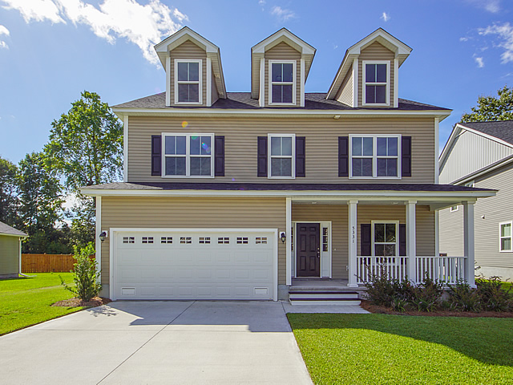
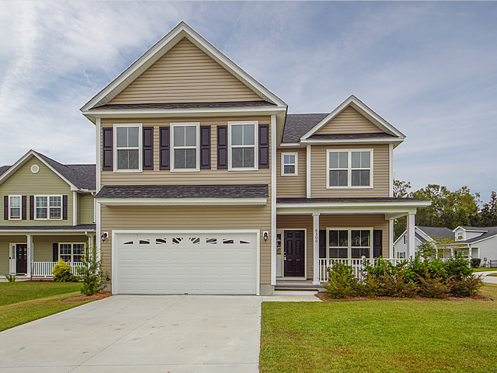

The Oaks at Indigo
5331 Natures Color Lane
MLS# 17033509
$349,000
4 Bdrm
4 Baths
Granite Counter Tops in kitchen
tiled master bath, separate shower, garden tub, double vanities
Hwd flooring on main floor
Mother-in-law suite on lst floor
$20 Gas Card with Showing & Feedback
8300 Cobalt Ct.
$339,900
MLS# 17033510
4 Bdrm
3.5 Bath
Hwd. flooring on main floor
Corner Lot on Cul-de-sac
Screened Porch
Granite Counter Tops in kitchen
Gas Range
Penny Shaffer
Cell (843) 475-0362
penny.shaffer@carolinaone.com
Cori Fisher
Cell (843) 952-6278
cori.fisher@carolinaone.com
Carolina One Real Estate | 1530 Trolley Road | Summerville, SC 29485

