Slide 1

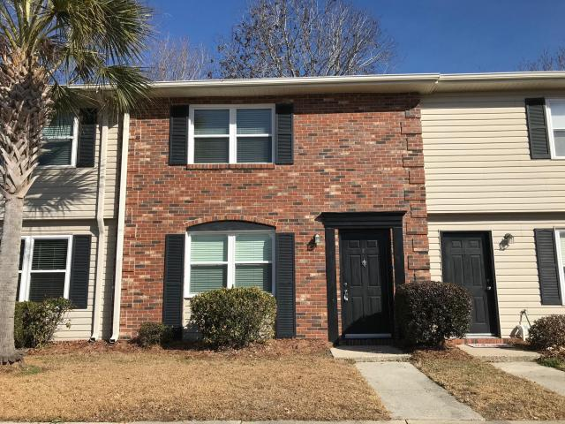
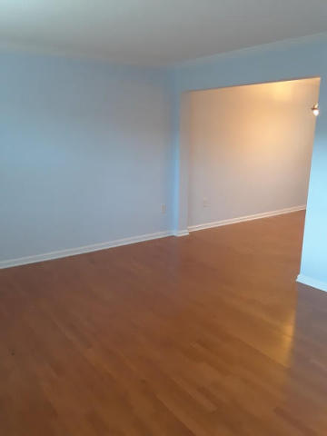
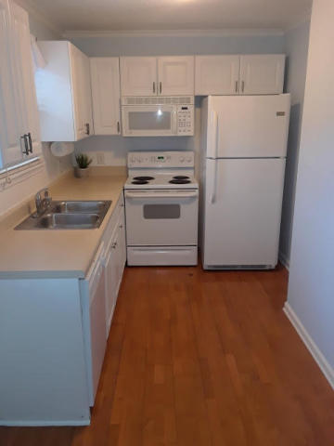
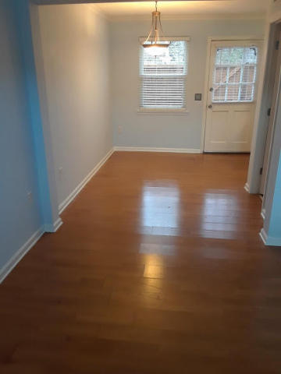
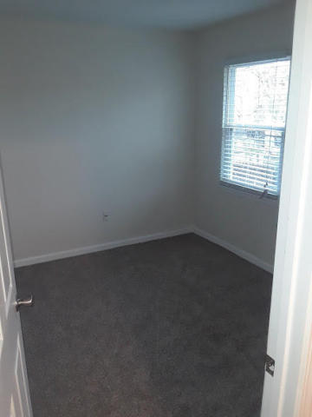
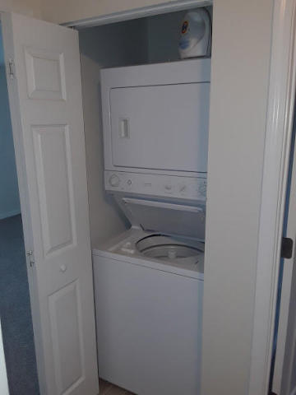


Featured Property
Week of February 9th, 2018
415 Parkdale Drive 17-E
Carolina Cove
Charleston, SC 29414
MLS# 18002123
$1,200
Beautiful open floor plan townhouse in Carolina Cove. Conveniently located within walking distance to the West Ashley Greenway; great biking and walking trails. Just a short drive to I-526, shopping malls, dining, beaches and about 15 minutes from Downtown Charleston. Home is newly painted, new carpet upstairs, all new faucet fixtures, new HVAC, refrigerator and dishwasher. In unit washer/dryer combo upstairs. Water is included. There is also a wonderful private courtyard patio in the back of the house. Huge green space and trees lead out from the back gate. The complex has a club house, pool, gym and play park. Very well kept grounds.
Under Contract in under 24 hours!
(843) 574-9100 info@crecpm.com Sit back, Relax...We've Got This!
118 West Richardson Avenue Summerville, SC 29483 | 3301 Salterbeck St Suite 100 Mt. Pleasant, SC 29466 | 2000 Sam Rittenberg Blvd Suite 118 Charleston, SC 29407
Watch our video to learn more about our services!

