Slide 1

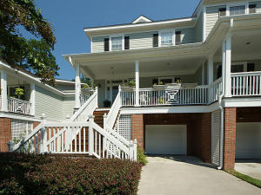
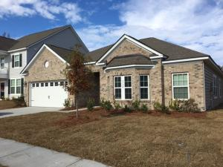
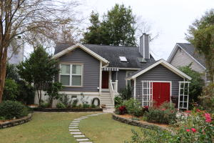
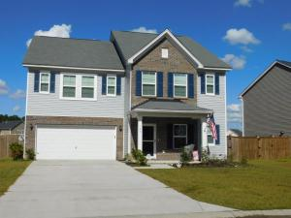
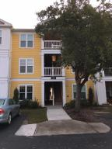
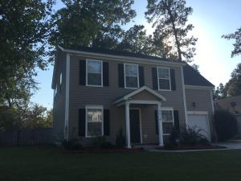
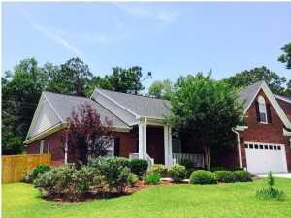
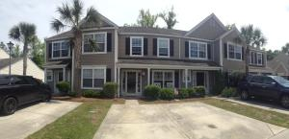

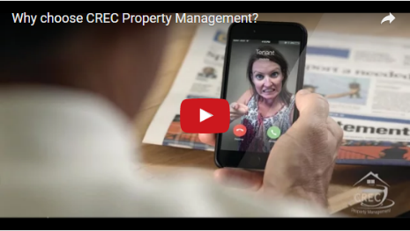
Available Rentals Week of January 9th, 2017
5394 5th Fairway Drive
Stono Ferry
Hollywood, SC 29449
MLS# 17000528
$1,750
9732 Table Mountain Ln
Coosaw Preserve
Ladson, SC 29456
MLS# 16030651
$2,200
1523 Barquentine Dr
Pirates Cove
Mount Pleasant, SC 29464
MLS# 16030984
$3,000
183 Charlesfort Way
Spring Grove Plantation
Moncks Corner, SC 29461
MLS# 16030192
$2,000
2411 Chatelain Way
Southampton Pointe
Mount Pleasant, SC 29464
MLS# 16029337
$1,500
2419 Stingray Blvd
Northwoods Pointe
North Charleston, SC 29406
MLS# 16028146
$1,600
1040 Blockade Runner Parkway
River Birch
Summerville, SC 29485
MLS# 16027579
$2,300
1305 Island Club Dr B
The Peninsula
Charleston, SC 29492
MLS# 16001411
$1,400
Under Contract in under 24 hours!
(843) 574-9100 info@crecpm.com Sit back, Relax...We've Got This!
118 West Richardson Avenue Summerville, SC 29483 | 3301 Salterbeck St Suite 100 Mt. Pleasant, SC 29466 | 2000 Sam Rittenberg Blvd Suite 118 Charleston, SC 29407
Watch our video to learn more about our services!

