Slide 1

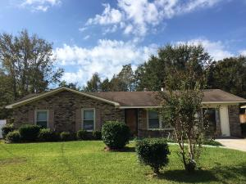
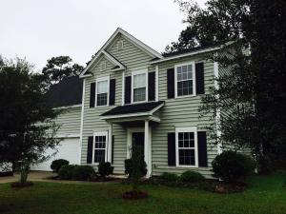
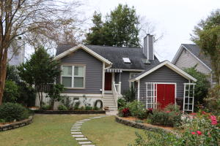
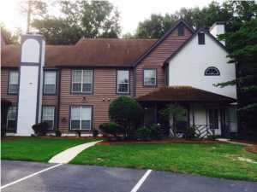
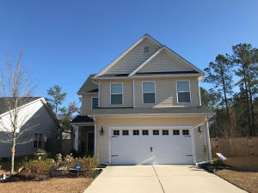
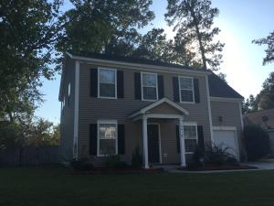
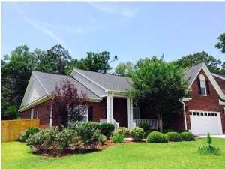
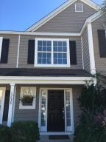

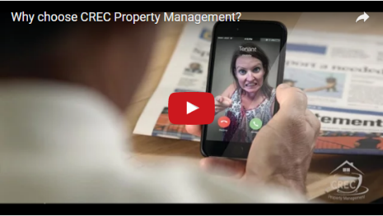
Available Rentals Week of January 30th, 2017
4443 Mixedwood Drive
Woodside Manor
Ladson, SC 29456
MLS# 16027216
$1,100
3 bd / 1.5 ba
129 Back Tee Circle
Legend Oaks Plantation
Summerville, SC 29485
MLS# 17000471
$2,100
4 bd / 3.5 ba
1523 Barquentine Dr
Pirates Cove
Mt Pleasant, SC 29464
MLS# 16030984
$2,900
3 bd / 3 ba
7935 Edgebrook Cr 2208
The Park at Rivers Edge
North Charleston, SC 29418
MLS# 17002051
$1,000
2 bd / 2 ba
124 Maywood Drive
Spring Grove Plantation
Moncks Corner, SC 29461
MLS# 17000086
$1,600
3 bd / 2.5 ba
2419 Stingray Blvd
Northwoods Pointe
N Charleston, SC 29406
MLS# 16028146
$1,550
4 bd / 2.5 ba
1040 Blockade Runner Parkway
River Birch
Summerville, SC 29485
MLS# 16027579
$2,300
3 bd / 2.5 ba
1305 Island Club Drive C
The Peninsula
Charleston, SC 29492
MLS# 17000085
$1,600
3 bd / 3.5 ba
Under Contract in under 24 hours!
(843) 574-9100 info@crecpm.com Sit back, Relax...We've Got This!
118 West Richardson Avenue Summerville, SC 29483 | 3301 Salterbeck St Suite 100 Mt. Pleasant, SC 29466 | 2000 Sam Rittenberg Blvd Suite 118 Charleston, SC 29407
Watch our video to learn more about our services!

