Slide 1

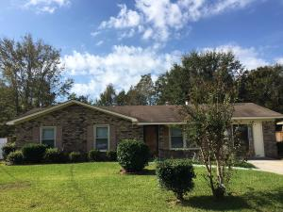
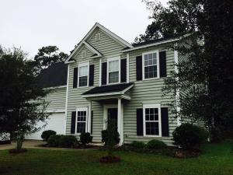
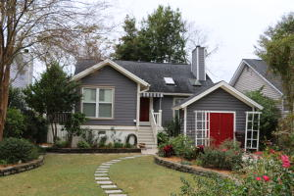
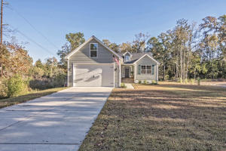
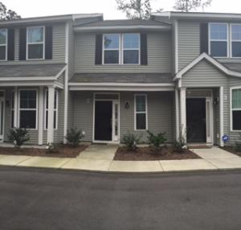
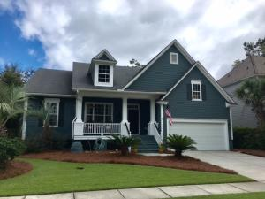
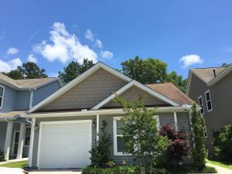
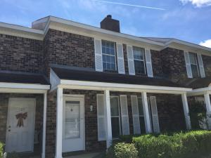

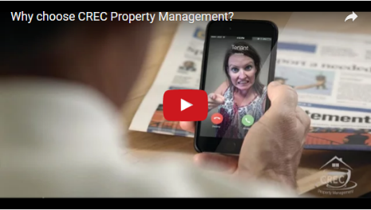
Available Rentals Week of February 20th, 2017
4443 Mixedwood Drive
Woodside Manor
Ladson, SC 29456
MLS# 16027216
$1,000
3 bd / 1.5 ba
129 Back Tee Circle
Legend Oaks Plantation
Summerville, SC 29485
MLS# 17000471
$2,100
4 bd / 3.5 ba
1523 Barquentine Dr
Pirates Cove
Mt Pleasant, SC 29464
MLS# 16030984
$2,900
3 bd / 3 ba
3501 Walter Drive
Cedar Springs
Johns Island, SC 29455
MLS# 17002693
$2,000
3 Bed / 2 Bath
7891 Champion Way B
The Park at Rivers Edge
N Charleston, SC 29418
MLS# 17004231
$1,250
2 Bed / 2.5 Bath
3329 Toomer Kiln Circle
Park West
Mt Pleasant, SC 29466
MLS# 17003281
$3,250
4 Bed / 4 Bath
8808 Shadowglen Drive
Charleston Park
N Charleston, SC 29420
MLS# 17003910
$1,300
3 Bed / 2 Bath
107 Sandlewood Drive
Corey Gardens
Summerville, SC 29483
MLS# 17004226
$1,100
3 Bed / 1.5 Bath
Under Contract in under 24 hours!
(843) 574-9100 info@crecpm.com Sit back, Relax...We've Got This!
118 West Richardson Avenue Summerville, SC 29483 | 3301 Salterbeck St Suite 100 Mt. Pleasant, SC 29466 | 2000 Sam Rittenberg Blvd Suite 118 Charleston, SC 29407
Watch our video to learn more about our services!

