Slide 1

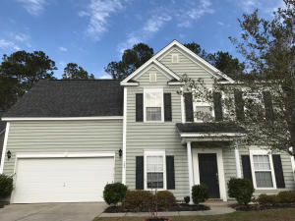
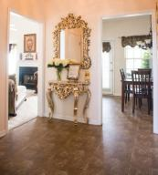
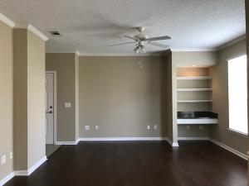
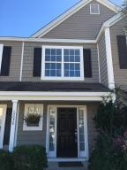
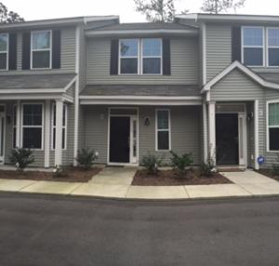
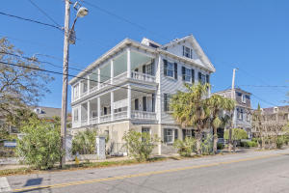
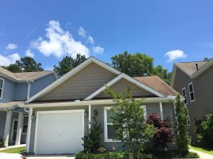
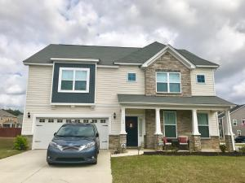

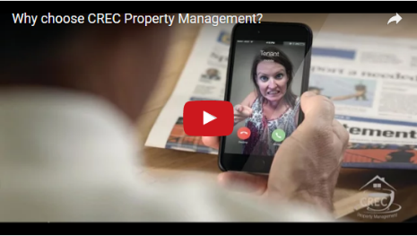
Available Rentals
Week of March 13th, 2017
129 Back Tee Circle
Legend Oaks Plantation
Summerville
MLS# 17000471
$2,000
4 Bed / 3.5 Bath
105 Applebee Court
Crowfield Plantation
Goose Creek
MLS# 17004225
$2,500
4 Bed / 2.5 Bath
45 Sycamore Ave 1434
Concord West of The Ashley
Charleston, SC 29407
MLS# 17006905
$1,100
1 Bed / 1 Bath
1305 Island Club Drive C
The Peninsula
Charleston
MLS# 17000085
$1,550
3 Bed / 3.5 Bath
7891 Champion Way B
The Park at Rivers Edge
North Charleston
MLS# 17004231
$1,250
2 Bed / 2.5 Bath
81 Ashley Avenue A
Harleston Village
Charleston, SC 29401
MLS# 17006277
$3,300
2 Bed / 2 Bath
8808 Shadowglen Drive
Charleston Park
North Charleston
MLS# 17003910
$1,300
3 Bed / 2 Bath
199 Charlesfort Way
Spring Grove Plantation
Moncks Corner
MLS# 17005604
$1,800
4 Bed / 2.5 Bath
Under Contract in under 24 hours!
(843) 574-9100 info@crecpm.com Sit back, Relax...We've Got This!
118 West Richardson Avenue Summerville, SC 29483 | 3301 Salterbeck St Suite 100 Mt. Pleasant, SC 29466 | 2000 Sam Rittenberg Blvd Suite 118 Charleston, SC 29407
Watch our video to learn more about our services!

