Slide 1

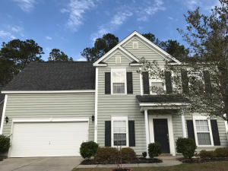
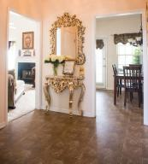
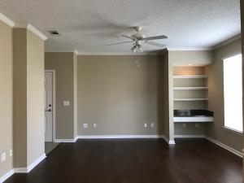
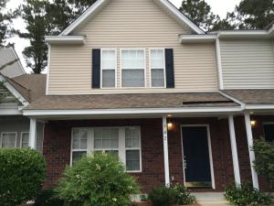
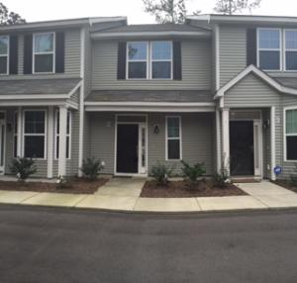
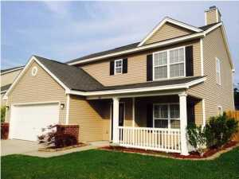
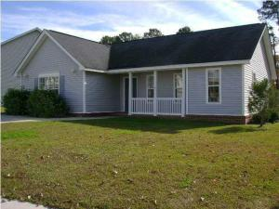
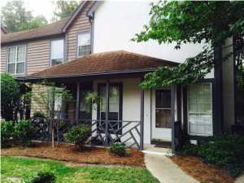

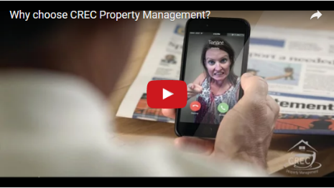
Available Rentals Week of March 20th, 2017
129 Back Tee Circle
Legend Oaks Plantation
Summerville
MLS# 17000471
$2,000
4 Bed / 3.5 Bath
105 Applebee Court
Crowfield Plantation
Goose Creek
MLS# 17004225
$2,500 4 Bed / 2.5 Bath
45 Sycamore Ave 1434
Concord West of The Ashley
Charleston, SC 29407
MLS# 17006905
$1,100
1 Bed / 1 Bath
502 Pond Pine Trail
Summer Wood
Summerville, SC 29483
MLS# 17007274
$1,300
2 Bed / 2.5 Bath
7891 Champion Way B
The Park at Rivers Edge
North Charleston
MLS# 17004231
$1,250
2 Bed / 2.5 Bath
404 Brookfield Lane
Liberty Hall Plantation
Goose Creek, SC 29445
MLS# 17007278
$1,600
4 Bed / 3 Bath
2102 Rockport Court
Summer Glen
Summerville, SC 29483
MLS# 17007277
$1,250
3 Bed / 2 Bath
7935 Edgebrook Circle #2208
The Park at Rivers Edge
North Charleston, SC 29418
MLS# 17002051
$1,000
2 Bed / 2 Bath
Under Contract in under 24 hours!
(843) 574-9100 info@crecpm.com Sit back, Relax...We've Got This!
118 West Richardson Avenue Summerville, SC 29483 | 3301 Salterbeck St Suite 100 Mt. Pleasant, SC 29466 | 2000 Sam Rittenberg Blvd Suite 118 Charleston, SC 29407
Watch our video to learn more about our services!

