Slide 1

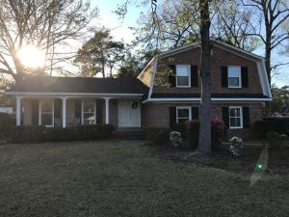
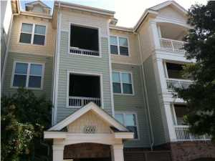
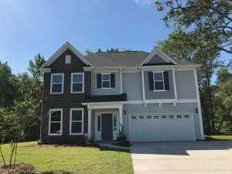
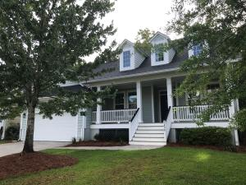
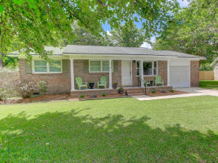
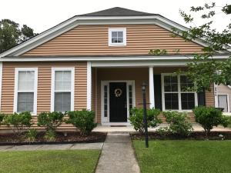
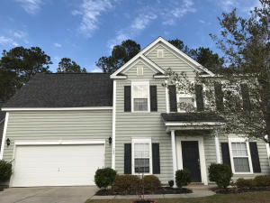
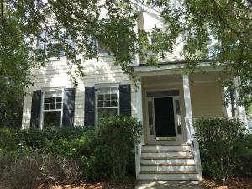

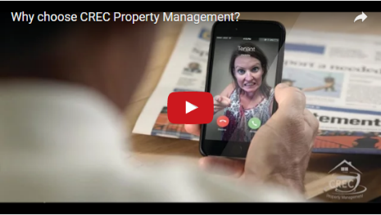
Available Rentals Week of June 26^{th,} 2017
2327 W Palmer Drive
Charleston
Charleston, SC 29414
MLS# 17012841
$1,900
4 Bed / 2.5 Bath
2244 Ashley Crossing Drive 616
Arboretum
Charleston, SC 29414
MLS# 17012337
$1,050
1 Bed / 1 Bath
1659 Fishbone Drive
Fenwick Woods
Johns Island, SC 29455
MLS# 17013991
$2,250
3 Bed / 2.5 Bath
3498 Toomer Kiln Circle
Park West
Mt Pleasant, SC 29466
MLS# 17015299
$2,900
4 Bed / 3.5 Bath
919 Randall Drive
Old Mt Pleasant
Mt Pleasant, SC 29464
MLS# 17015170
$2,300
3 Bed / 1 Bath
8946 Planters Row Lane
Wescott Plantation
Summerville, SC 29485
MLS# 17015972
$1,425
3 Bed / 2 Bath
129 Back Tee Circle
Legend Oaks Plantation
Summerville, SC 29485
MLS# 17000471
$1,850
4 Bed / 3.5 Bath
1414 Elfe Street
Daniel Island
Charleston, SC 29492
MLS# 17017685
$2,500
3 Bed / 2.5 Bath
Under Contract in under 24 hours!
(843) 574-9100 info@crecpm.com Sit back, Relax...We've Got This!
118 West Richardson Avenue Summerville, SC 29483 | 3301 Salterbeck St Suite 100 Mt. Pleasant, SC 29466 | 2000 Sam Rittenberg Blvd Suite 118 Charleston, SC 29407
Watch our video to learn more about our services!

