Slide 1

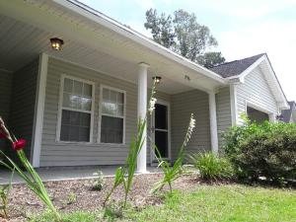
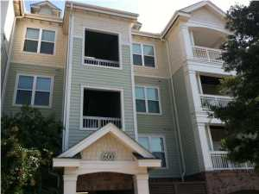
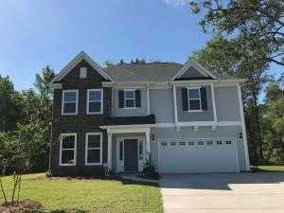
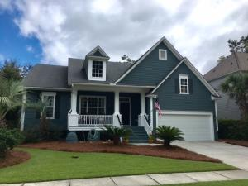
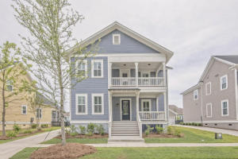
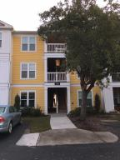
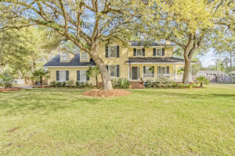
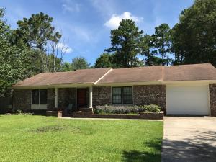

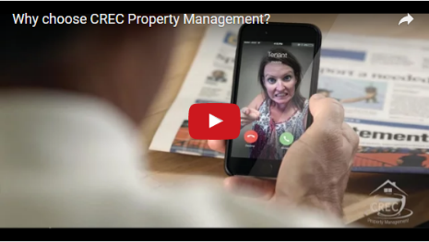
Available Rentals Week of July 17^{th,} 2017
796 Bunkhouse Drive
The Shadows
Charleston, SC 29414
MLS# 17017703
$1,700
4 Bed / 2 Bath
2244 Ashley Crossing Drive 616
Arboretum
Charleston, SC 29414
MLS# 17012337
$990
1 Bed / 1 Bath
1659 Fishbone Drive
Fenwick Woods
Johns Island, SC 29455
MLS# 17013991
$2,250
3 Bed / 2.5 Bath
329 Toomer Kiln Circle
Park West
Mt Pleasant, SC 29466
MLS# 17015696
$3,150
4 Bed / 2 Bath
1543 Harriman Street
Carolina Park
Mt Pleasant, SC 29466
MLS# 17020023
$3,200
5 Bed / 3.5 Bath
2411 Chatelain Way Southampton Pointe
Mt Pleasant, SC 29464
MLS# 17018970
$1,550
2 Bed / 2.5 Bath
115 Tyvola Drive
Ashley Forest
Summerville, SC 29485
MLS# 17018863
$2,500
4 Bed / 2.5 Bath
109 Chestnut Court Sangaree
Summerville, SC 29486
MLS# 17019961
$1,125
3 Bed / 2 Bath
Under Contract in under 24 hours!
(843) 574-9100 info@crecpm.com Sit back, Relax...We've Got This!
118 West Richardson Avenue Summerville, SC 29483 | 3301 Salterbeck St Suite 100 Mt. Pleasant, SC 29466 | 2000 Sam Rittenberg Blvd Suite 118 Charleston, SC 29407
Watch our video to learn more about our services!

