Slide 1

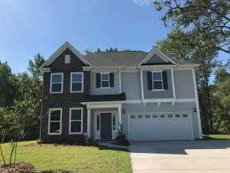
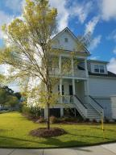
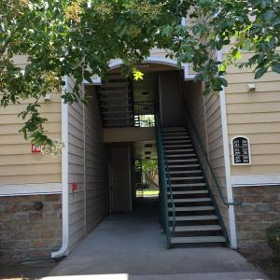
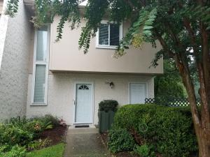
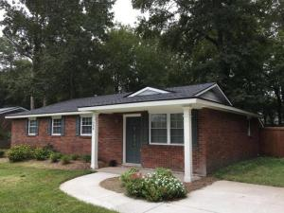
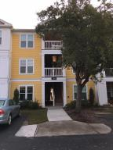
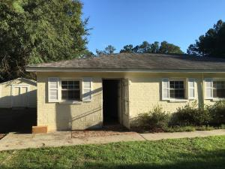
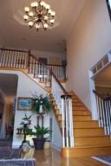

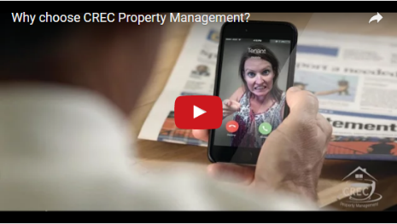
Available Rentals Week of July 31st, 2017
1659 Fishbone Drive
Fenwick Woods
Johns Island, SC 29455
MLS# 17013991
$2,250
3 Bed / 2.5 Bath
2226 Dewees Creek Dr
Oyster Point
Mt Pleasant, SC 29466
MLS# 17020321
$3,300
4 Bed / 3.5 Bath
1300 Park West Blvd 206
Park West
M Pleasant, SC 29466
MLS# 17018973
$1,400
2 Bed / 2 Bath
508 Ventura Place
Snee Farm
Mt Pleasant, SC 29464
MLS# 17020190
$1,825
3 Bed / 2.5 Bath
508 Golf Road
Summerville Heights
Summerville, SC 29483
MLS# 17020805
$1,350
4 Bed / 2.5 Bath
2411 Chatelain Way Southampton Pointe
Mt Pleasant, SC 29464
MLS# 17018970
$1,550
2 Bed / 2.5 Bath
921 Simmons Avenue A
Summerville, SC 29483
MLS# 17020082
$765
2 Bed / 1 Bath
107 Waterstone Way
Crowfield Plantation
Goose Creek, SC 29445
MLS# 17020076
$3,450
5 Bed / 4.5 Bath
Under Contract in under 24 hours!
(843) 574-9100 info@crecpm.com Sit back, Relax...We've Got This!
118 West Richardson Avenue Summerville, SC 29483 | 3301 Salterbeck St Suite 100 Mt. Pleasant, SC 29466 | 2000 Sam Rittenberg Blvd Suite 118 Charleston, SC 29407
Watch our video to learn more about our services!

