Slide 1

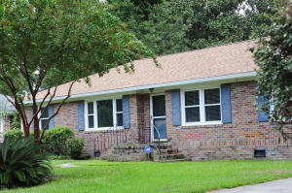
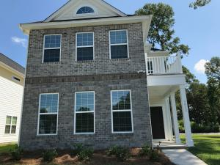
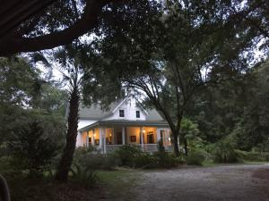
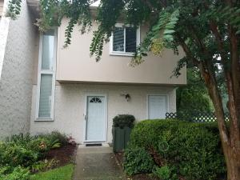
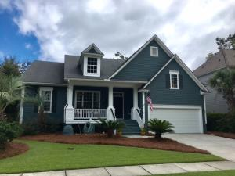
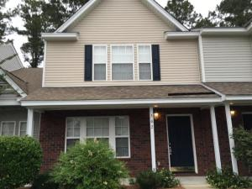
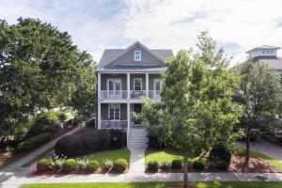
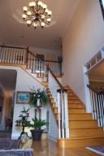

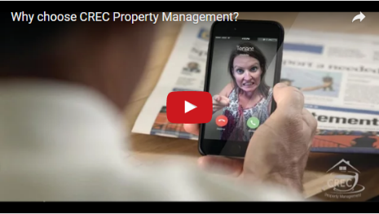
Available Rentals
Week of August 28th, 2017
1367 Tara Road
Lenevar
Charleston, SC 29407
MLS# 17023109
$1,995
3 Bed / 2 Bath
3012 Plumier Place
Magnolia Bluff
Charleston, SC 29414
MLS# 17023554
$2,900
3 Bed / 2.5 Bath
1079 Corbetts Alley
Loblolly Bay Forest
Johns Island, SC 29455
MLS# 17022776
$4,800
3 Bed / 2.5 Bath
508 Ventura Place
Snee Farm
Mt Pleasant, SC 29464
MLS# 17020190
$1,825
3 Bed / 2.5 Bath
3329 Toomer Kiln Circle
Park West
Mt Pleasant, SC 29466
MLS# 17015696
$3,000
4 Bed / 2 Bath
502 Pond Pine Trail
Summer Wood
Summerville, SC 29483
MLS# 17022991
$1,300
2 Bed / 2.5 Bath
8021 Gibbon Street
Daniel Island
Charleston, SC 29492
MLS# 17020682
$3,950
3 Bed / 2.5 Bath
107 Waterstone Way
Crowfield Plantation
Goose Creek, SC 29445
MLS# 17020076
$3,450
5 Bed / 4.5 Bath
Under Contract in under 24 hours!
(843) 574-9100 info@crecpm.com Sit back, Relax...We've Got This!
118 West Richardson Avenue Summerville, SC 29483 | 3301 Salterbeck St Suite 100 Mt. Pleasant, SC 29466 | 2000 Sam Rittenberg Blvd Suite 118 Charleston, SC 29407
Watch our video to learn more about our services!

