Slide 1

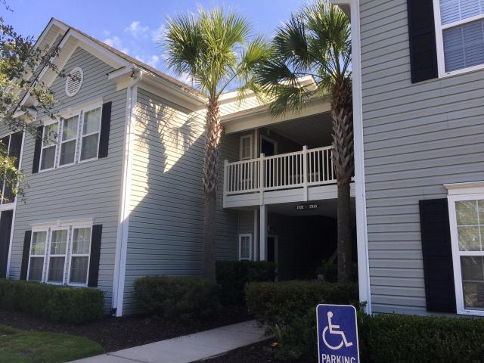
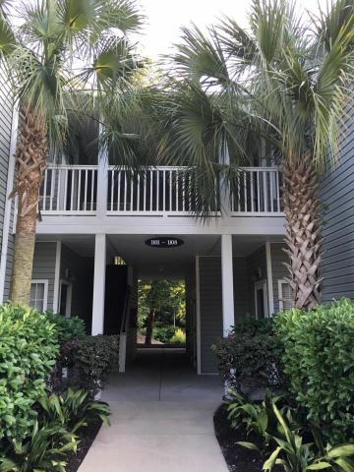
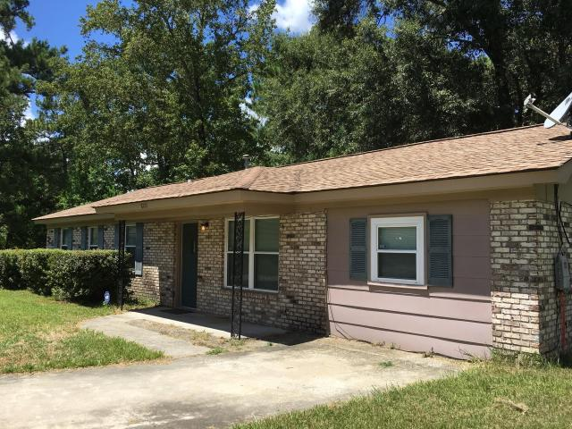
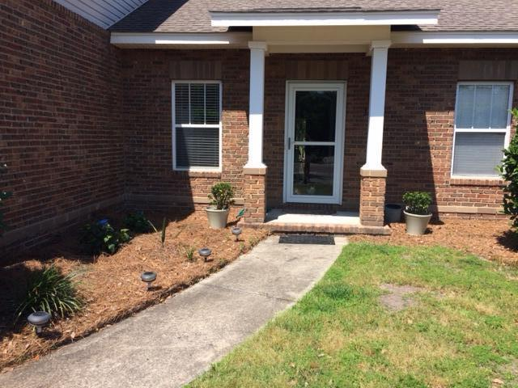
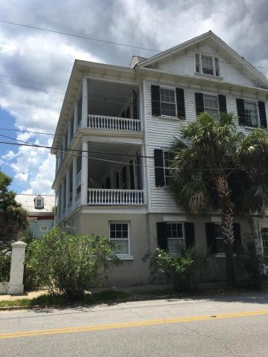
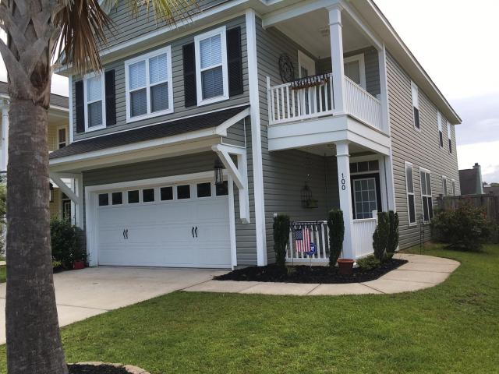
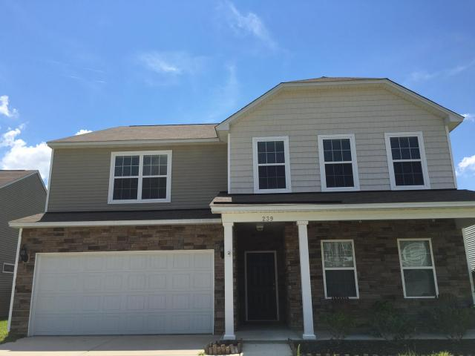
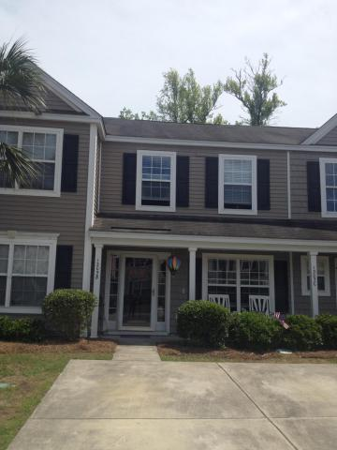

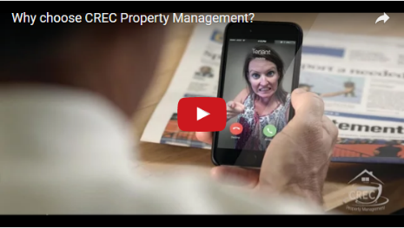
Available Rentals Week of September 5th, 2016
1705 N Elgin Court
Charleston
MLS# 16019495
$1,400
1103 Grove Park Drive
Charleston
MLS# 16013943
$1,850
Under Contract in 11 Days!
8727 Auburn Drive
North Charleston
MLS# 16023276
$1,100
1667 Lauda Drive
Mount Pleasant
MLS# 16020223
$1,600
Under Contract in 3 Days!
Under Contract in 11 Days!
Under Contract in 5 Days!
81 Ashley Avenue A
Charleston
MLS# 16019500
$3,000
100 Alumni Court
Ladson
MLS# 16021435
$1,650
Under Contract in 7 Days!
Under Contract in 2 Days!
239 Decatur Drive
Summerville
MLS# 16022018
$1,900
1305 Island Club Drive B
Charleston
MLS# 16001411
$1,500
Under Contract in under 24 hours!
(843) 574-9100 info@crecpm.com Sit back, Relax...We've Got This!
118 West Richardson Avenue Summerville, SC 29483 | 3301 Salterbeck St Suite 100 Mt. Pleasant, SC 29466 | 2000 Sam Rittenberg Blvd Suite 118 Charleston, SC 29407
Watch our video to learn more about our services!

