Slide 1

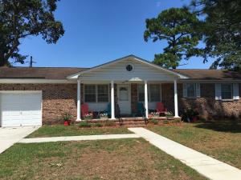
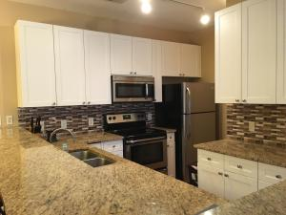
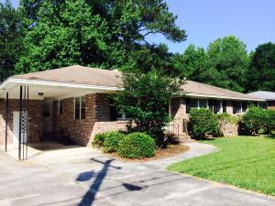
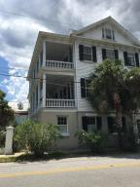
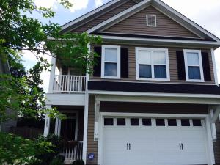
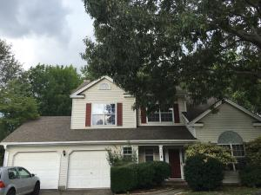
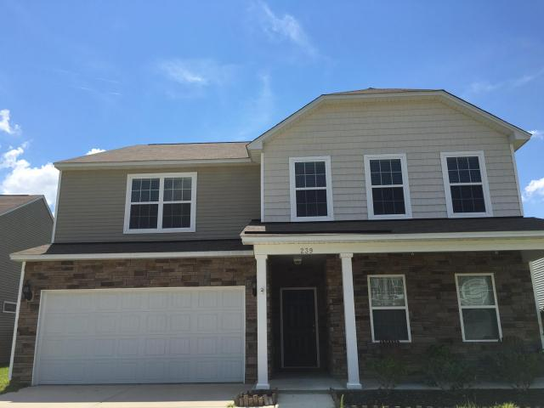
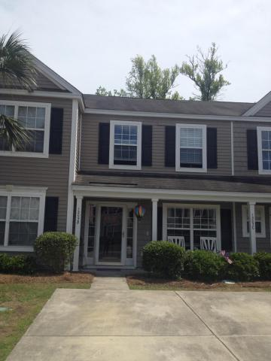

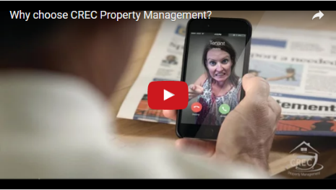
Available Rentals Week of September 19th, 2016
1448 Manor Boulevard
Ashley Hall Manor
Charleston
MLS# 16023745
$1,600
1705 N Elgin Court
Grand Oaks Plantation
Charleston
MLS# 16019495
$1,400
4739 Mimosa Street
Wando Woods
North Charleston
MLS# 16023808
$1,400
81 Ashley Avenue A
Harleston Village
Charleston
MLS# 16019500
$3,000
385 Chemistry Circle
Eagle Run
Ladson
MLS# 16024222
$1,650
103 Chesterton Drive
Crowfield Plantation
Goose Creek
MLS# 16019776
$1,750
239 Decatur Drive
Cane Bay Plantation
Summerville
MLS# 16022018
$1,900
1305 Island Club Dr B
The Peninsula
Charleston
MLS# 16001411
$1,500
Under Contract in under 24 hours!
(843) 574-9100 info@crecpm.com Sit back, Relax...We've Got This!
118 West Richardson Avenue Summerville, SC 29483 | 3301 Salterbeck St Suite 100 Mt. Pleasant, SC 29466 | 2000 Sam Rittenberg Blvd Suite 118 Charleston, SC 29407
Watch our video to learn more about our services!

