Slide 1

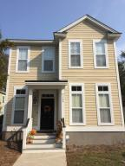
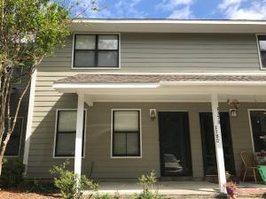
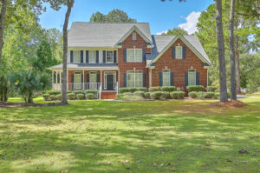
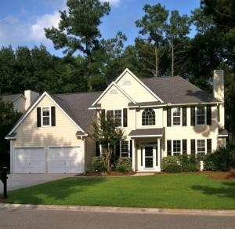
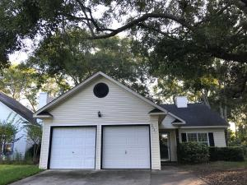
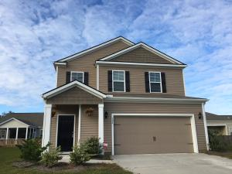

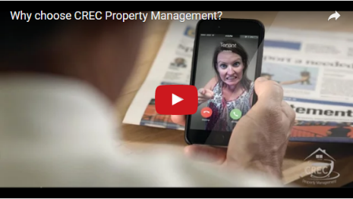
Available Rentals Week of October 30th, 2017
1786 Cornsilk Drive
Carolina Bay
Charleston
MLS# 17018965
$2,100
4 Bed / 3.5 Bath
1180 Julian Clark Rd 16
Island Bluff
Charleston
MLS# 17025539
$1,300
2 Bed / 1.5 Bath
3214 Cottonfield Drive
Dunes West
Mount Pleasant
MLS# 17027113
$3,400
4 Bed / 4 Bath
2766 Merwether Lane
Brickyard Plantation
Mount Pleasant
MLS# 17028577
$2,600
4 Bed / 2.5 Bath
2021 Arundel Place Longpoint
Mount Pleasant
MLS# 17026358
$1,950
3 Bed / 2 Bath
304 Southern Sugar Ave
Cypress Ridge
Moncks Corner
MLS# 17026012
$1,450
3 Bed / 2.5 Bath
Under Contract in under 24 hours!
(843) 574-9100 info@crecpm.com Sit back, Relax...We've Got This!
118 West Richardson Avenue Summerville, SC 29483 | 3301 Salterbeck St Suite 100 Mt. Pleasant, SC 29466 | 2000 Sam Rittenberg Blvd Suite 118 Charleston, SC 29407
Watch our video to learn more about our services!

