Slide 1

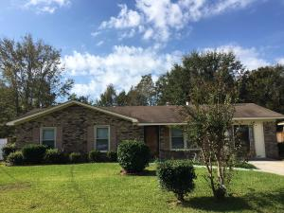
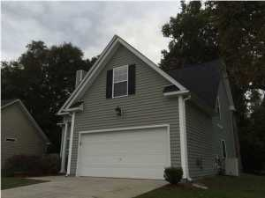
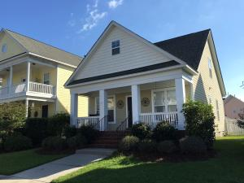
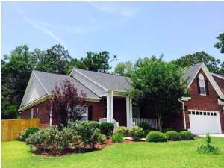
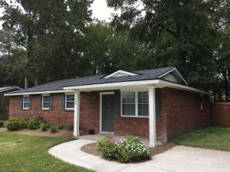
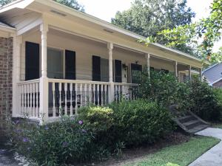
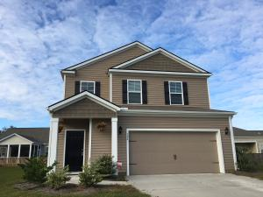
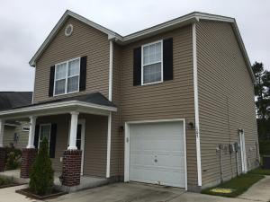

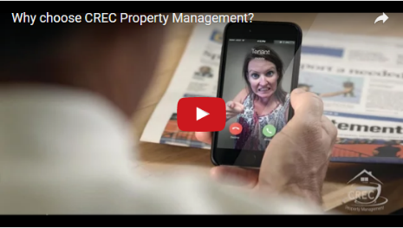
Available Rentals Week of October 31st, 2016
4443 Mixedwood Drive
Woodside Manor
Ladson, SC 29456
MLS# 16027216
$1,100
100 Equinox Circle
Heatherwoods
Ladson, SC 29456
MLS# 16026756
$1,600
207 Barberry Street
White Gables
Summerville, SC 29483
MLS# 16026059
$1,500
1040 Blockade Runner Parkway
River Birch
Summerville, SC 29485
MLS# 16027579
$2,300
508 Golf Road
Summerville Heights
Summerville, SC 29483
MLS# 16026373
$1,400
102 Deer Run Court
Crowfield Plantation
Goose Creek, SC 29445
MSL# 16026219
$1,650
304 Southern Sugar Avenue
Cypress Ridge
Moncks Corner, SC 29461
MLS# 16026668
$1,500
105 Cranston Lane
Weatherstone
Summerville, SC 29483
MLS# 16026418
$1,400
Under Contract in under 24 hours!
(843) 574-9100 info@crecpm.com Sit back, Relax...We've Got This!
118 West Richardson Avenue Summerville, SC 29483 | 3301 Salterbeck St Suite 100 Mt. Pleasant, SC 29466 | 2000 Sam Rittenberg Blvd Suite 118 Charleston, SC 29407
Watch our video to learn more about our services!

