Slide 1

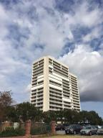
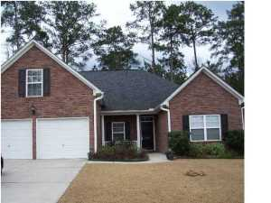
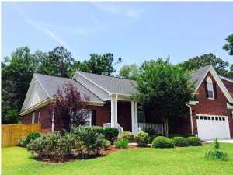
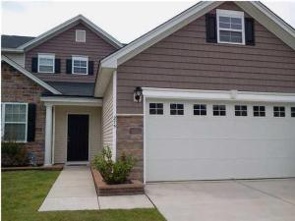
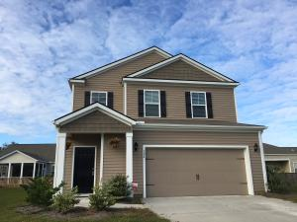
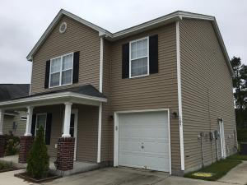
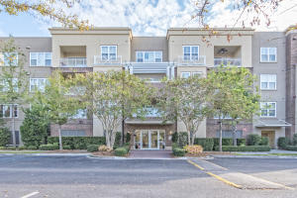
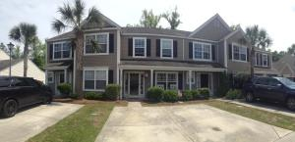

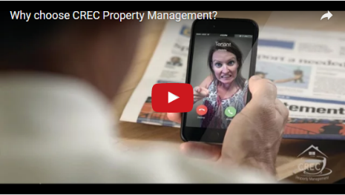
Available Rentals Week of November 7th, 2016
330 Concord Street 3b
Dockside
Charleston, SC 29401
MLS# 16028335
$3,000
8719 Evangeline Drive
Cedar Grove
North Charleston, SC 29420
MLS# 16028156
$1,600
1040 Blockade Runner Pkwy
River Birch
Summerville, SC 29485
MLS# 16027579
$2,300
275 Clayburne Drive
Liberty Hall Plantation
Goose Creek, SC 29445
MLS# 16028159
$1,650
304 Southern Sugar Ave
Cypress Ridge
Moncks Corner, SC 29461
MLS# 16026668
$1,500
105 Cranston Lane
Weatherstone
Summerville, SC 29483
MLS# 16026418
$1,400
200 River Landing Dr H302
Daniel Island
Charleston, SC 29492
MLS# 16028598
$3,200
1305 Island Club Dr B
The Peninsula
Charleston, SC 29492
MLS# 16001411
$1,450
Under Contract in under 24 hours!
(843) 574-9100 info@crecpm.com Sit back, Relax...We've Got This!
118 West Richardson Avenue Summerville, SC 29483 | 3301 Salterbeck St Suite 100 Mt. Pleasant, SC 29466 | 2000 Sam Rittenberg Blvd Suite 118 Charleston, SC 29407
Watch our video to learn more about our services!

