Slide 1

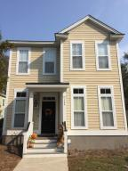
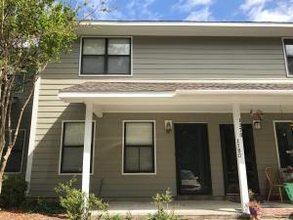
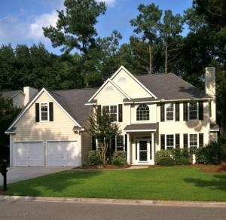
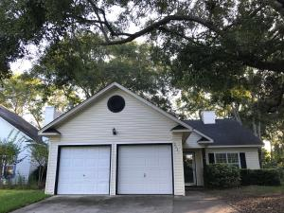
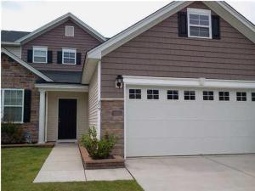
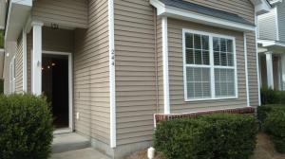
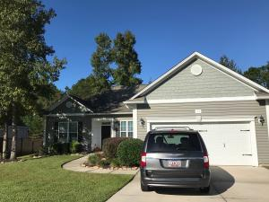
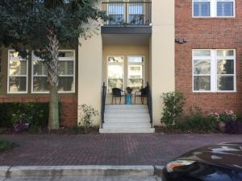

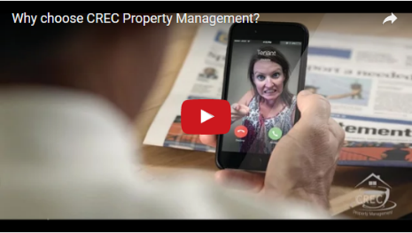
Available Rentals Week of November 20th, 2017
1786 Cornsilk Drive
Carolina Bay
Charleston, SC 29414
MLS# 17018965
$2,000
4 Bed / 3.5 Bath
1180 Julian Clark Rd 16
Island Bluff
Charleston, SC 29412
MLS# 17025539
$1,300
2 Bed / 1.5 Bath
2766 Merwether Lane
Brickyard Plantation
Mount Pleasant, SC 29466
MLS# 17028577
$2,600
4 Bed / 2.5 Bath
2021 Arundel Place
Longpoint
Mount Pleasant, SC 29464
MLS# 17026358
$1,950
3 Bed / 2 Bath
275 Clayburne Drive
Liberty Hall Plantation
Goose Creek, SC 29445
MLS# 17030466
$1,600
4 Bed / 3.5 Bath
244 Brookshire Road 45
Liberty Hall Plantation
Goose Creek, SC 29445
MLS# 17028775
$1,400
3 Bed / 2.5 Bath
309 Carriage Wheel Rd
Spring Grove Plantation
Moncks Corner, SC 29461
MLS# 17028939
$1,550
3 Bed / 2 Bath
125 Pier View Street 105
Daniel Island
Charleston, SC 29492
MLS# 17026535
$1,800
2 Bed / 2 Bath
Under Contract in under 24 hours!
(843) 574-9100 info@crecpm.com Sit back, Relax...We've Got This!
118 West Richardson Avenue Summerville, SC 29483 | 3301 Salterbeck St Suite 100 Mt. Pleasant, SC 29466 | 2000 Sam Rittenberg Blvd Suite 118 Charleston, SC 29407
Watch our video to learn more about our services!

