Slide 1

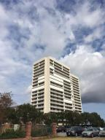
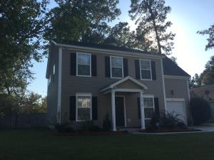
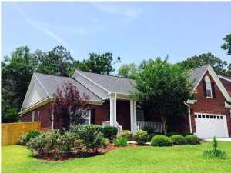
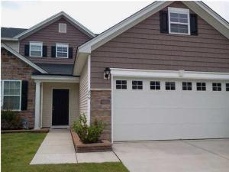
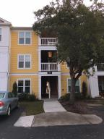
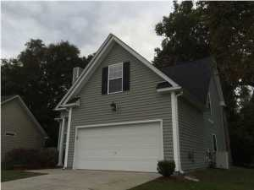
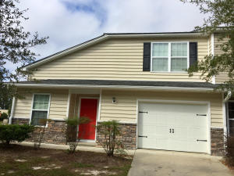
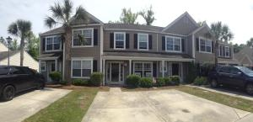

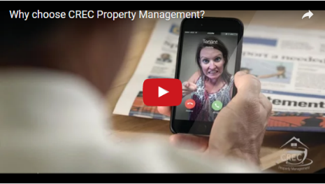
Available Rentals Week of November 21th, 2016
330 Concord Street 3b
Dockside
Charleston, SC 29401
MLS# 16028335
$3,000
2419 Stingray Boulevard
Northwoods Pointe
North Charleston, SC 29406
MLS# 16028146
$1,600
1040 Blockade Runner Pkwy
River Birch
Summerville, SC 29485
MLS# 16027579
$2,300
275 Clayburne Drive
Liberty Hall Plantation
Goose Creek, SC 29445
MLS# 16028159
$1,650
2411 Chatelain Way
Southampton Pointe
Mount Pleasant, SC 29464
MLS# 16029337
$1,500
100 Equinox Circle
Heatherwoods
Ladson, SC 29456
MLS# 16026756
$1,600
204 Tyner Trail
Cobblestone Ridge
Summerville, SC 29486
MLS# 16028165
$1,400
1305 Island Club Dr B
The Peninsula
Charleston, SC 29492
MLS# 16001411
$1,450
Under Contract in under 24 hours!
(843) 574-9100 info@crecpm.com Sit back, Relax...We've Got This!
118 West Richardson Avenue Summerville, SC 29483 | 3301 Salterbeck St Suite 100 Mt. Pleasant, SC 29466 | 2000 Sam Rittenberg Blvd Suite 118 Charleston, SC 29407
Watch our video to learn more about our services!

