Slide 1

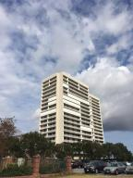
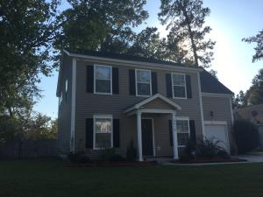
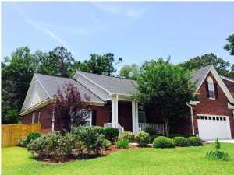
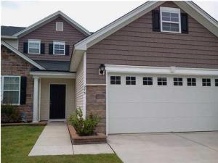
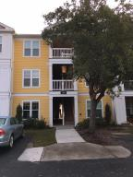
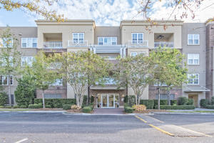
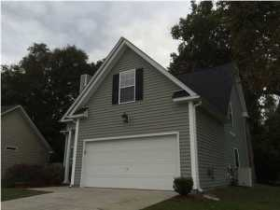
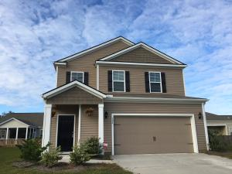

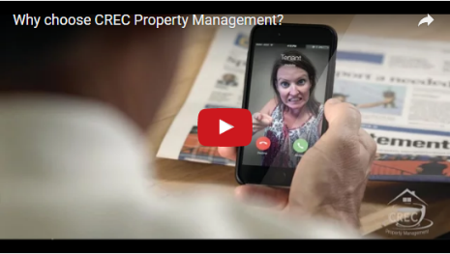
Available Rentals
Week of November 28th, 2016
330 Concord Street 3b
Dockside
Charleston, SC 29401
MLS# 16028335
$3,000
2419 Stingray Boulevard
Northwoods Pointe
North Charleston, SC 29406
MLS# 16028146
$1,600
1040 Blockade Runner Pkwy
River Birch
Summerville, SC 29485
MLS# 16027579
$2,300
275 Clayburne Drive
Liberty Hall Plantation
Goose Creek, SC 29445
MLS# 16028159
$1,650
2411 Chatelain Way
Southampton Pointe
Mount Pleasant, SC 29464
MLS# 16029337
$1,500
200 River Landing Drive H302
Daniel Island
Charleston, SC 29492
MLS# 16028598
$3,200
100 Equinox Circle
Heatherwoods
Ladson, SC 29456
MLS# 16026756
$1,600
304 Southern Sugar Ave
Cypress Ridge
Moncks Corner, SC 29461
MLS# 16026668
$1,500
Under Contract in under 24 hours!
(843) 574-9100 info@crecpm.com Sit back, Relax...We've Got This!
118 West Richardson Avenue Summerville, SC 29483 | 3301 Salterbeck St Suite 100 Mt. Pleasant, SC 29466 | 2000 Sam Rittenberg Blvd Suite 118 Charleston, SC 29407
Watch our video to learn more about our services!

