Slide 1

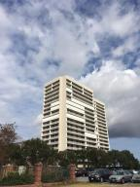
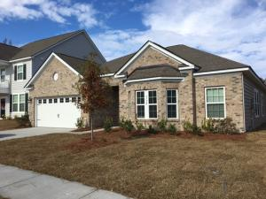
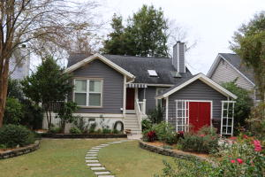
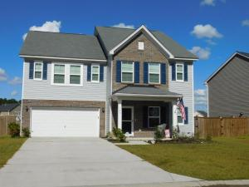
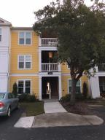
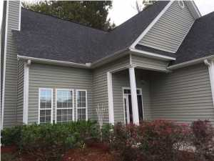
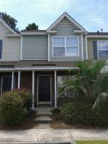
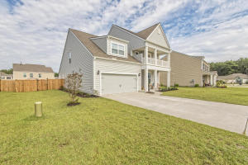

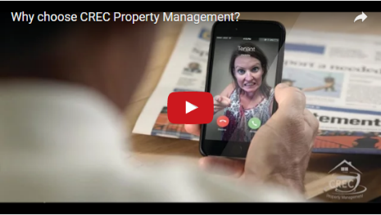
Available Rentals
Week of December 19th, 2016
330 Concord Street 3b
Dockside
Charleston, SC 29401
MLS# 16028335
$3,000
9732 Table Mountain Ln
Coosaw Preserve
Ladson, SC 29456
MLS# 16030651
$2,200
1523 Barquentine Dr
Pirates Cove
Mount Pleasant, SC 29464
MLS# 16030984
$3,100
183 Charlesfort Way
Spring Grove Plantation
Moncks Corner, SC 29461
MLS# 16030192
$2,000
2411 Chatelain Way
Southampton Pointe
Mount Pleasant, SC 29464
MLS# 16029337
$1,500
100 Equinox Circle
Heatherwoods
Ladson, SC 29456
MLS# 16031241
$1,600
115 Hornby Circle
Persimmon Hill
Goose Creek, SC 29445
MLS# 16031317
$975
514 Morelets Drive
Cypress Ridge
Moncks Corner, SC 29461
MLS# 16031541
$1,700
Under Contract in under 24 hours!
(843) 574-9100 info@crecpm.com Sit back, Relax...We've Got This!
118 West Richardson Avenue Summerville, SC 29483 | 3301 Salterbeck St Suite 100 Mt. Pleasant, SC 29466 | 2000 Sam Rittenberg Blvd Suite 118 Charleston, SC 29407
Watch our video to learn more about our services!

