Slide 1
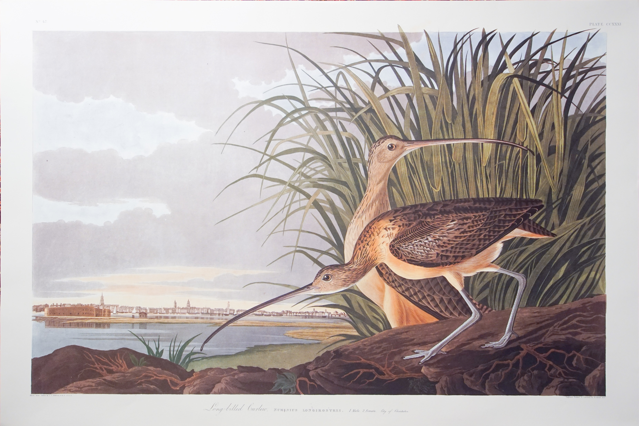
Looking For An Amazing Closing Gift?
So you’ve just helped your client buy their dream Lowcountry home and now you’re wondering “what can I give them as a one-of-a-kind ‘Welcome Home’ gift?”
Or perhaps you just helped a client sell their home and they are leaving this beautiful area.
Consider giving them a truly unique, limited edition Audubon print, featuring many of the birds and scenes they are about to enjoy here or in their new location!
The available prints are all from the 1985 Abbeville Edition of “Birds of America”. Each print can be delivered locally or shipped anywhere in the US for free.
There are currently 44 prints from this collection available, ranging in price from $125 to $2800.
You can buy directly online or you can review the options and call to discuss an offline purchase. Any questions, please call Thomas at 843-224-6359
The “Long-Billed Curlew” is a prized print for the Lowcountry as it shows the Charleston harbor & peninsula in the background.

