Slide 1
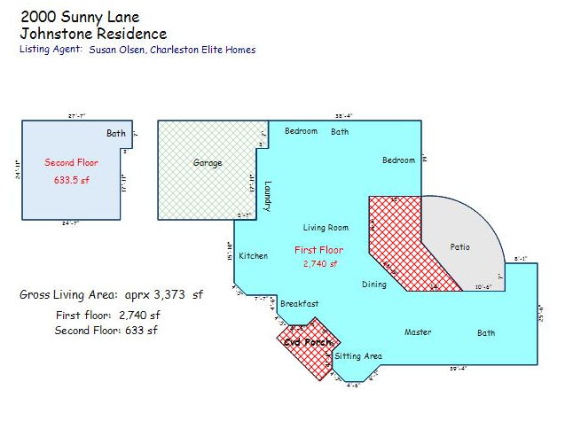
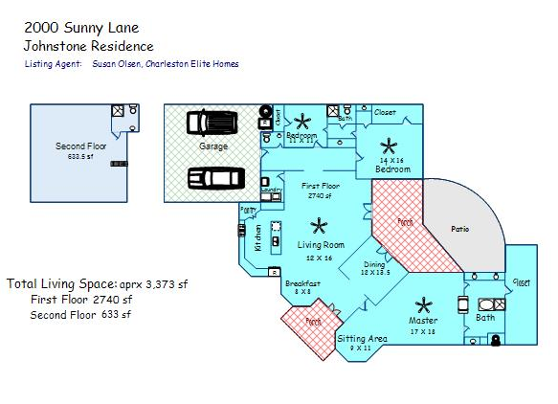
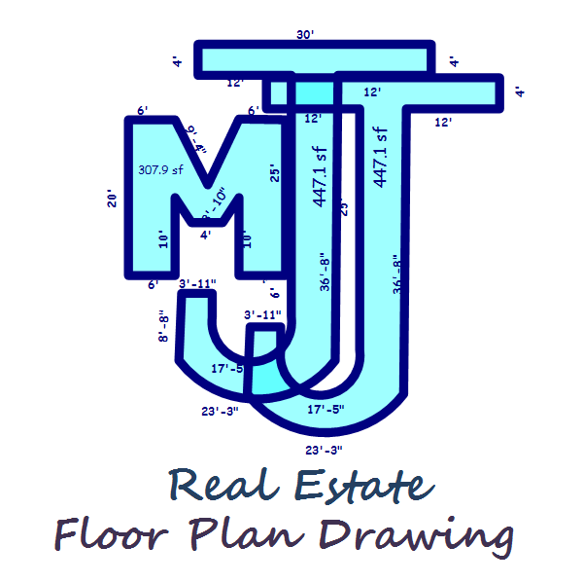
House plans are an important item
to include on your MLS listings!
_______________________________________
Check out my website below for information on what types of house plan drawings I offer, and see samples below.
Please call me for any other information you may need.
Thanks! Mischelle
Mischelle Johnstone
MJJ Real Estate Plan Drawing
843-303-2161
www.mjjplandrawing.com

