Slide 1
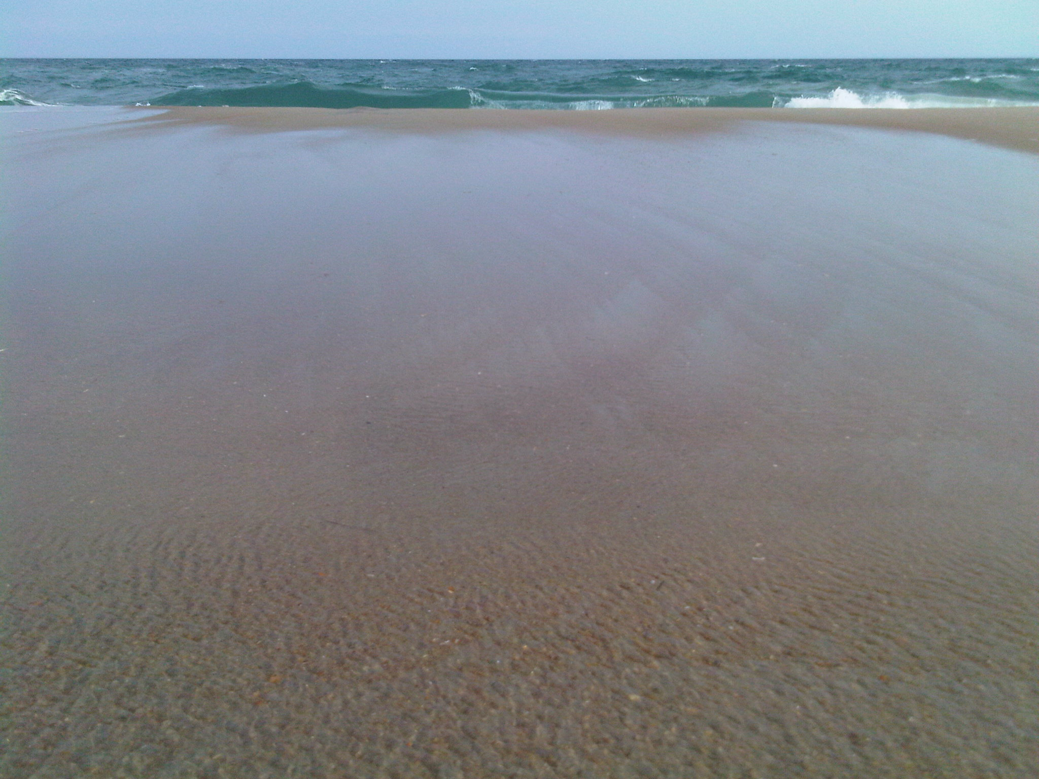

Vacation Time is Coming Up Soon!
We will be “slowing down” for our annual summer break July 12th to July 21st so that Mendi and Thomas can spend time away with their families.
We will not be shooting or processing any tours during this time. You are welcome to continue to place orders to be shot when we get back. Mendi will be able to coordinate with you on scheduling. If you know you have a listing that might be ready before we take our break, please consider ordering/scheduling for as soon as possible.
MailBlasts ordering will be disabled. If you anticipate needing some help with email marketing during this time, please plan accordingly and order ahead of time.
We hope you had/have a chance to spend some quality time with your loved ones as well.
We will be back to our normal full-service 24-48 hour delivery beginning July 22nd!
support@cvh360.com | cvh360.com
Thomas 843-224-6359 | Mendi 843-323-6236

